Slide 1
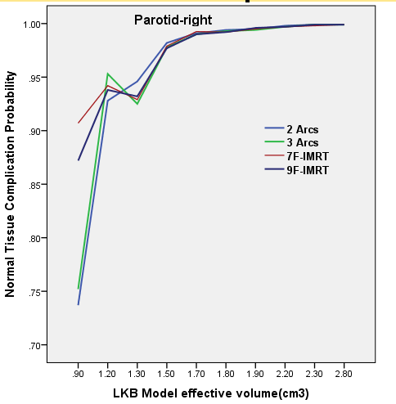
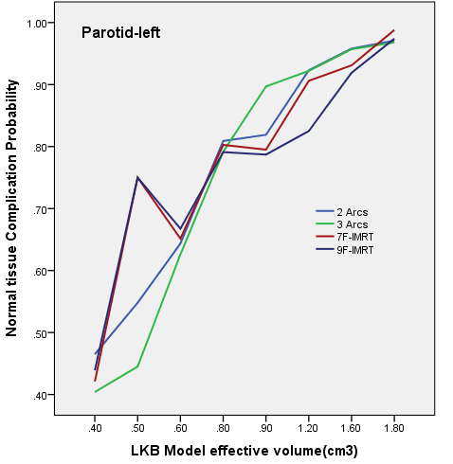
(a)
(b)
Supplementary Fig. 6. Line graph comparisons between NTCP and LKB model’s effective volume for (a) parotid-right and (b) parotid-left

Slide 2
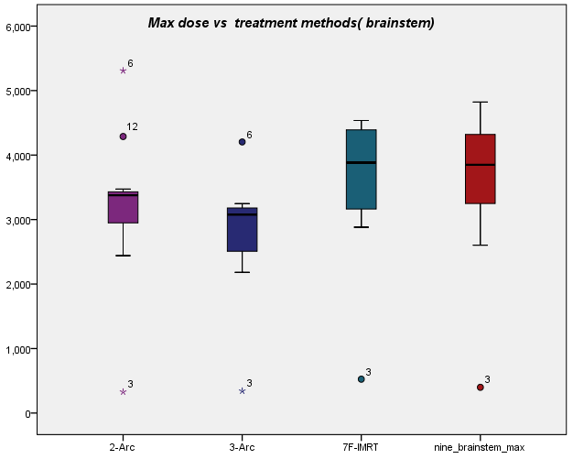
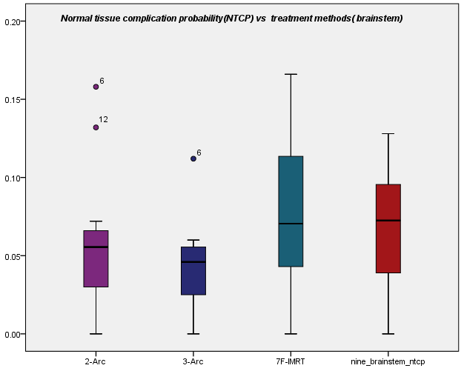
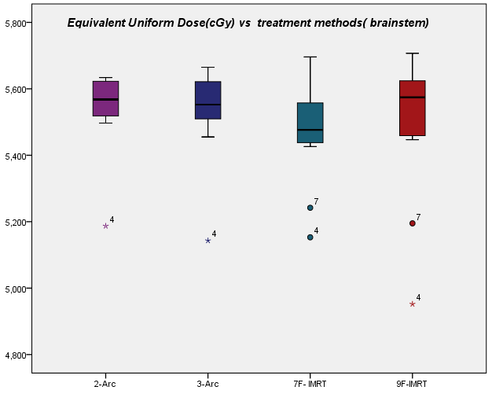
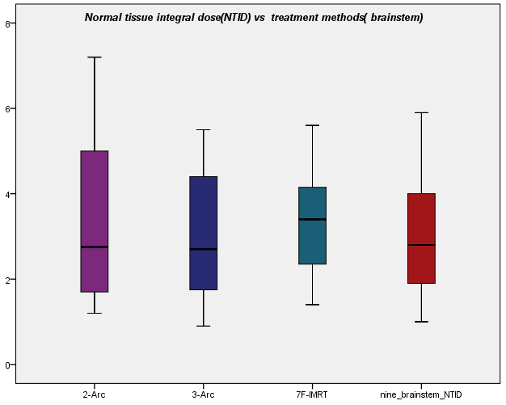
(b)
(c) (d)
Supplementary Fig. 7. Box-whisker plot of the brainstem (OAR) in 2-arc, 3-arc, 7F-IMRT, and 9F-IMRT treatment planning for (a) Max dose (b) NTCP (c) EUD and (d) NTID

Slide 3
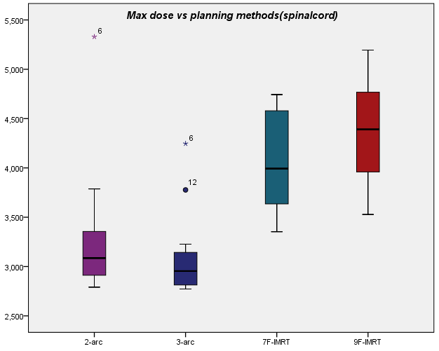
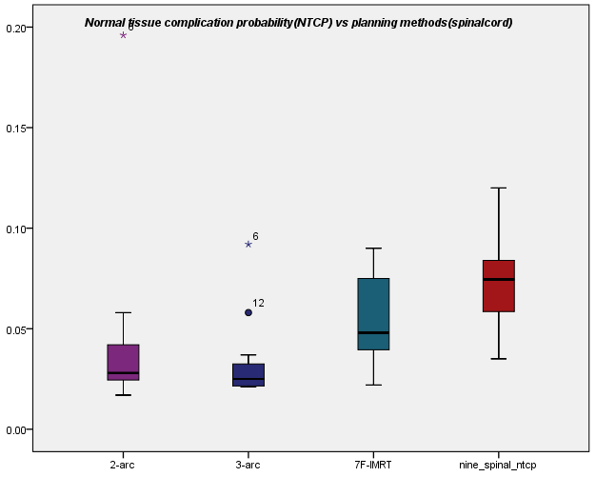
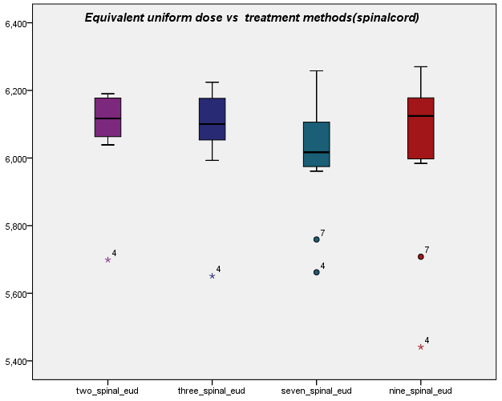
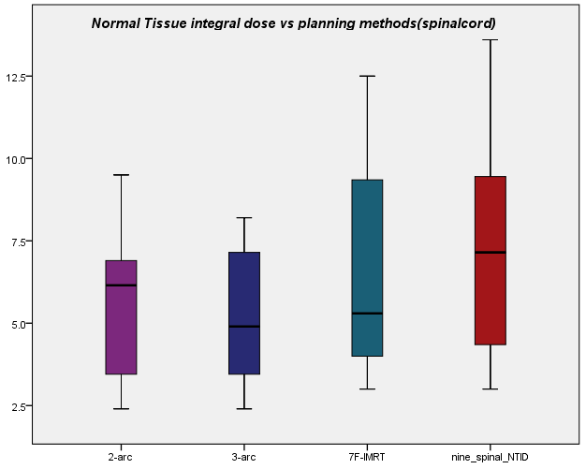
(a)
(b)
(c)
(d)
Supplementary Fig. 8 Box-whisker plot of the spinal cord (OAR) in 2-arc, 3-arc, 7F-IMRT, and 9F-IMRT treatment planning for (a) Max dose (b) NTCP (c) EUD and (d) NTID

Slide 4
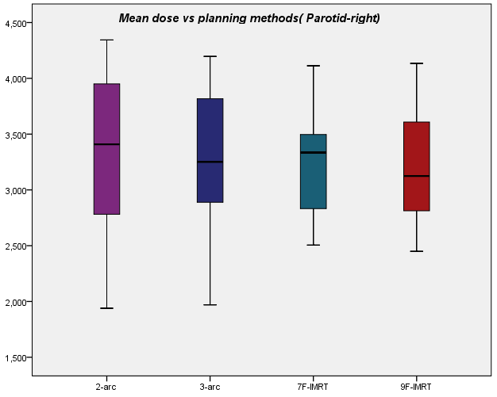
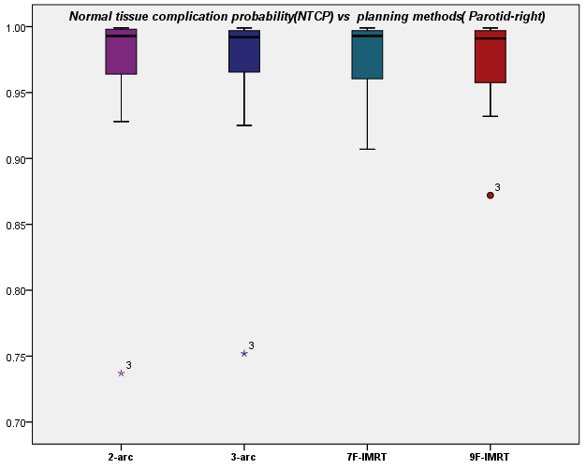
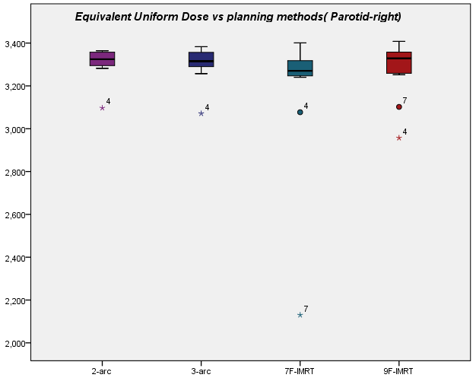
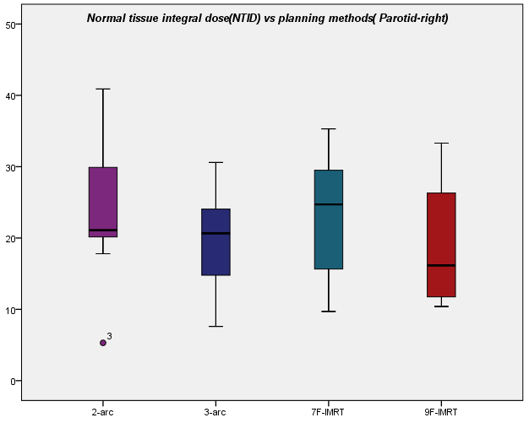
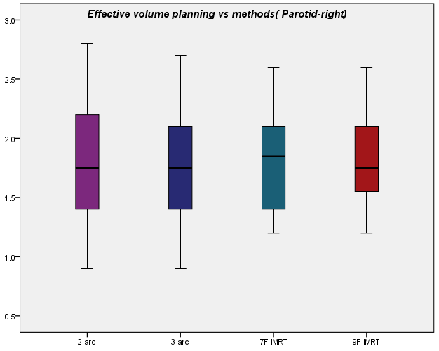
Supplementary Fig. 9. Box-whisker plot of parotid right (OAR) in 2-arc, 3-arc, 7F-IMRT, and 9F-IMRT treatment planning for (a) max dose, (b) NTCP, (c) EUD and (d) NTID, and (e) effective volume.

Slide 5
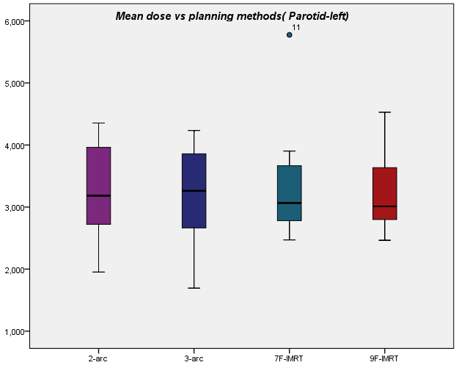
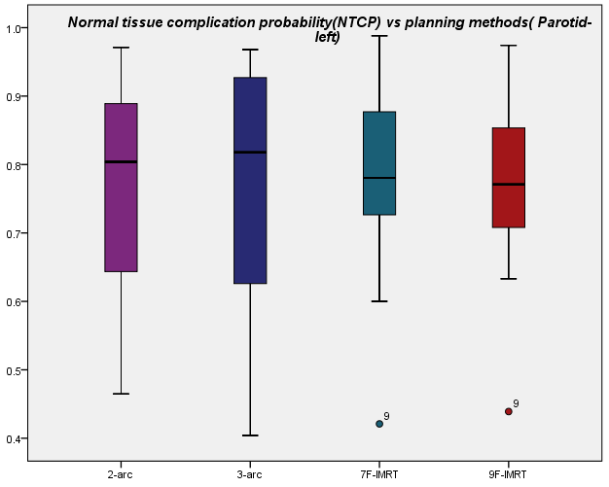
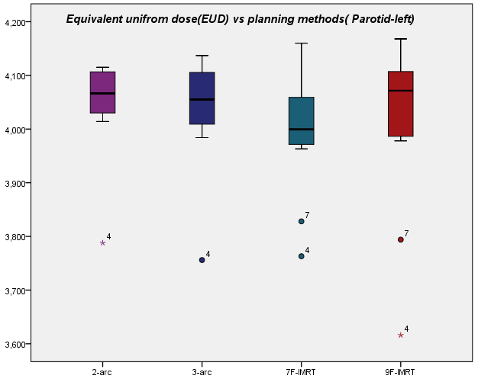
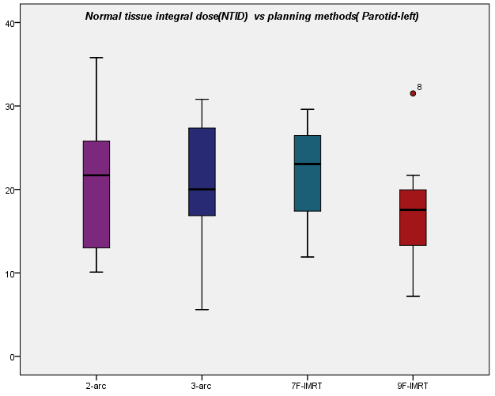
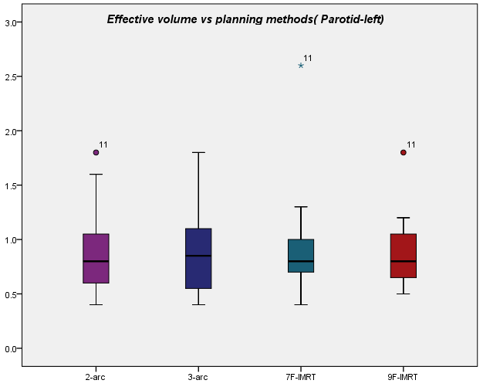
Supplementary Fig. 10. Box-whisker plot of parotid left (OAR) in 2-arc, 3-arc, 7F-IMRT, and 9F-IMRT treatment planning for (a) max dose, (b) NTCP, (c) EUD and (d) NTID, and (e) effective volume.

Slide 6
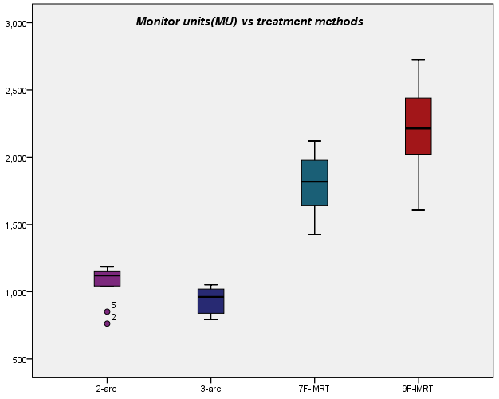
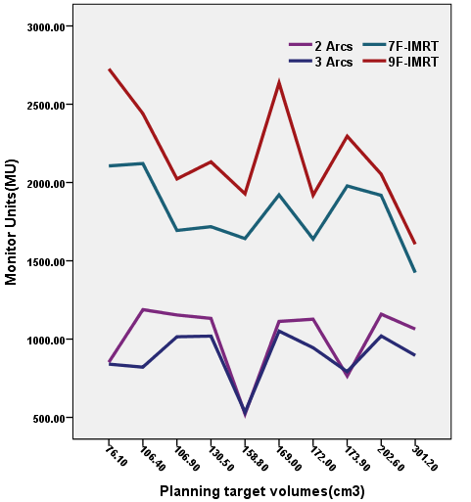
Supplementary Fig 11 (a) Box-whisker plot of monitor units (MU) in 2-arc, 3-arc, 7F-IMRT, and 9F-IMRT treatment methods (b) Line graph of monitor units compared with PTV volumes in all planning methods

Slide 7
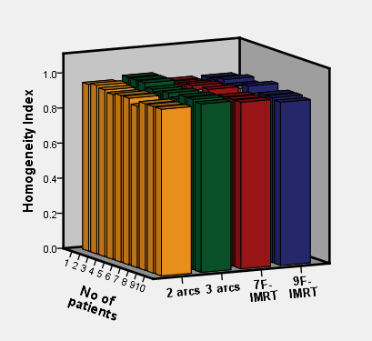
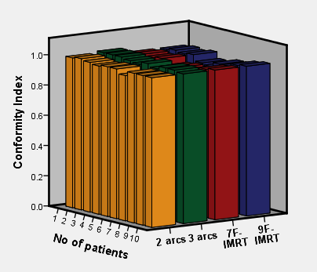
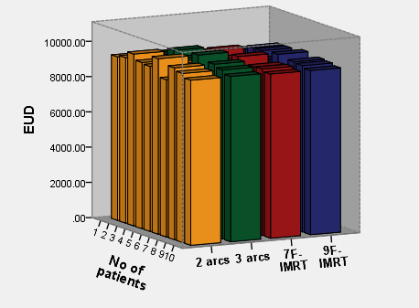
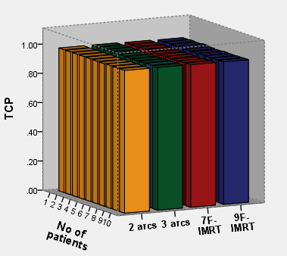
(a)
(b )
(d)
(c)
Supplementary Fig 12. 3D bar chart for (a) homogeneity, (b) conformity, (c) EUD, and (d) TCP of the target
volumes from all four planning methods

Slide 8
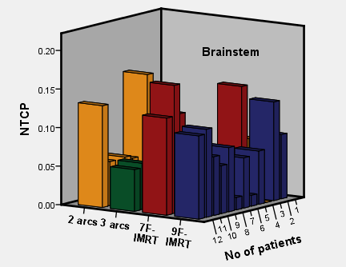
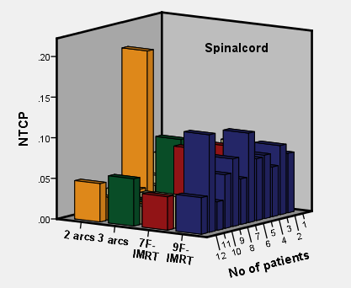
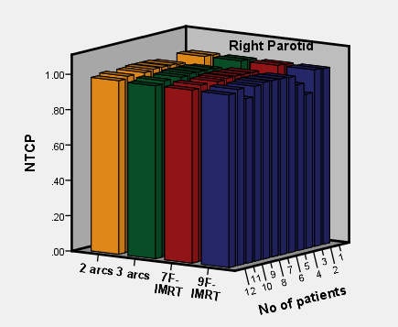
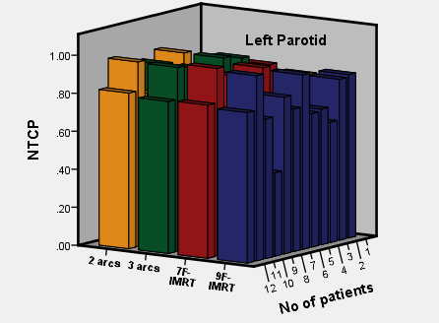
(a)
(b)
(c)
(d)
Supplementary Fig. 13. 3D bar chart of NTCP for organs at risk (a) brainstem, (b) spinal cord (c) right-parotid, and (d) left-parotid from all four planning methods

