Slide 1
Figure S1. Flowchart of study inclusion

Slide 2
Figure S2. Random effects meta-analysis of the association between ever use of smokeless tobacco and lung cancer
The ORs fore each study are presented as squares, with the position of the square corresponding to the point estimate and the 95% CI shown by horizontal lines. (95% Cis for each study shown in the forest plot are obtained by back transformation using the calculated standard error shown in the analysis and do not always conform exactly to the stated confidence intervals in the paper). The area of the square Is inversely proportional to the variance in the OR. The diamond represents the pooled OR and it’s 95% CI

Slide 3
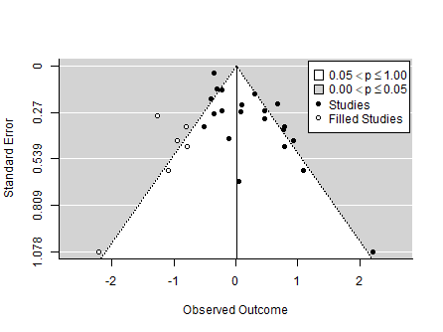
Figure S3. Funnel plot of studies of ever use of any type of smokeless tobacco and risk of lung cancer

Slide 4
Figure S4a. Random effects meta-analysis of the association between ever use of smokeless tobacco and lung cancer in studies from Asia
In sensitivity analysis pooled OR varied from 1.13 (95%CI (0.86 – 1.48)) to 1.35 (95%CI (0.96 – 1.90)

Slide 5
Figure S4b. Random effects meta-analysis of the association between ever use of smokeless tobacco and lung cancer in studies from Europe and North America
In sensitivity analysis pooled OR varied from 1.11 (95%CI 0.71 – 1.74) to 1.38 (95%CI 0.85 – 2.23)

Slide 6
Figure S4c. Random effects meta-analysis of the association between ever use of smokeless tobacco and lung cancer in studies from Africa
In sensitivity analysis pooled OR varied from 0.94 (95%CI 0.47 – 1.90) to 1.73 (95%CI 0.82 – 3.66)
When analysis was repeated using a fixed effects model the pooled OR was 1.29 (95%CI 0.74 – 2.25)

