Slide 1
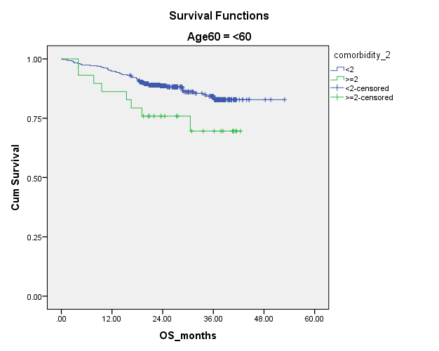
Number at risk
P= 0.03
<2 | 419 | 397 | 220 | 90 | 2 | 0
>=2 | 28 | 25 | 14 | 8 | 0 | 0
Supplementary Figure 1 : OS in patients aged <60 years with presence of <2 and >=2 comorbidities

