Slide 1
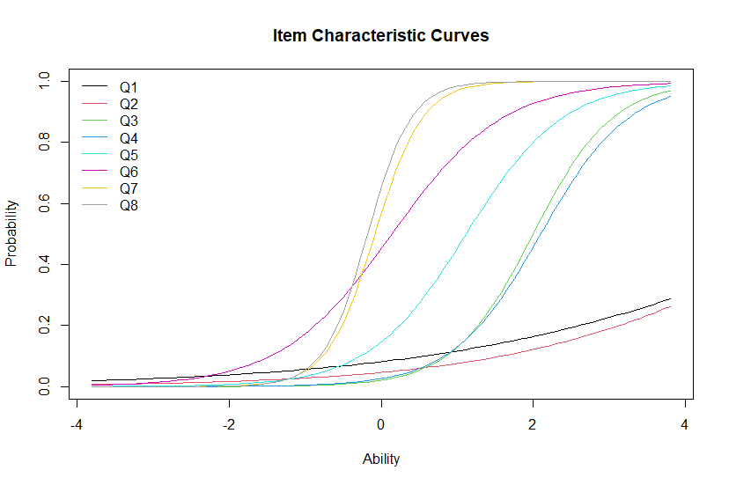
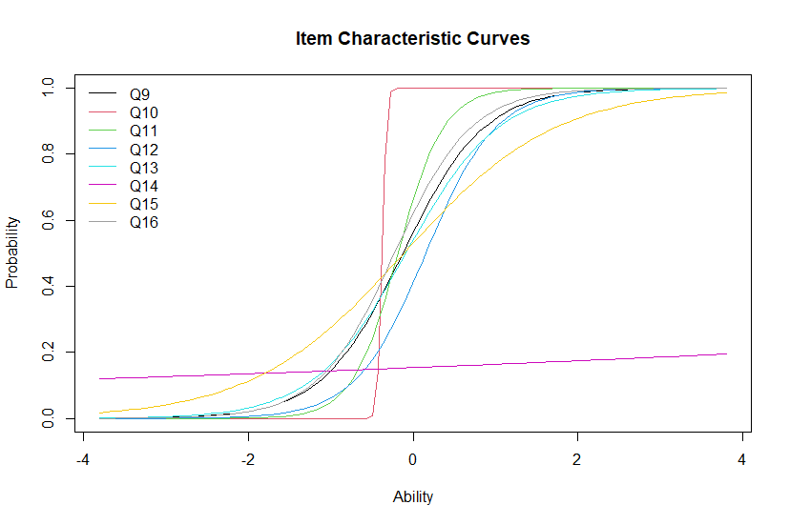
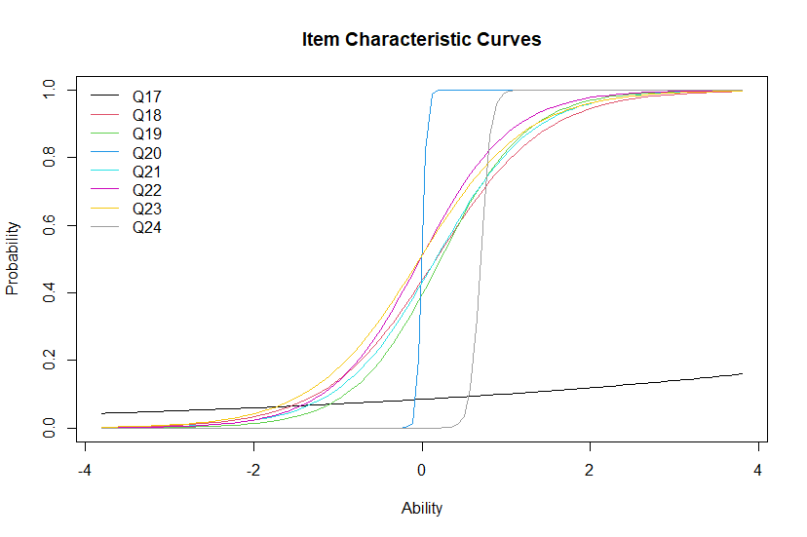
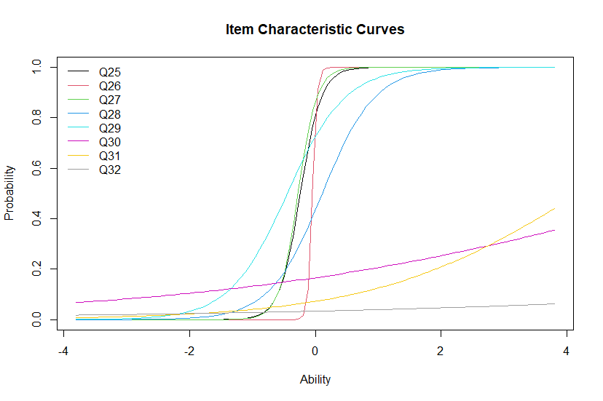
Appendix E. RStudio output plots

Slide 2
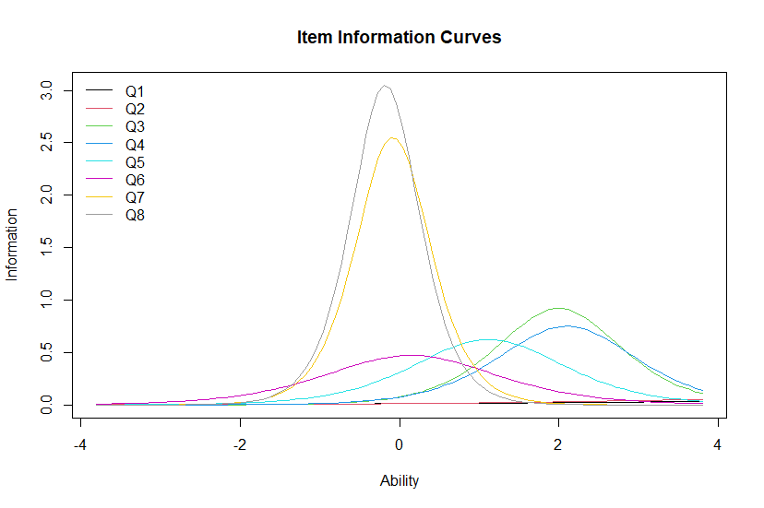
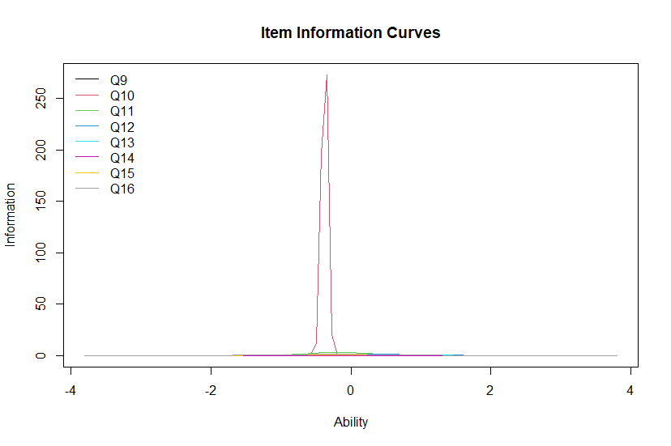
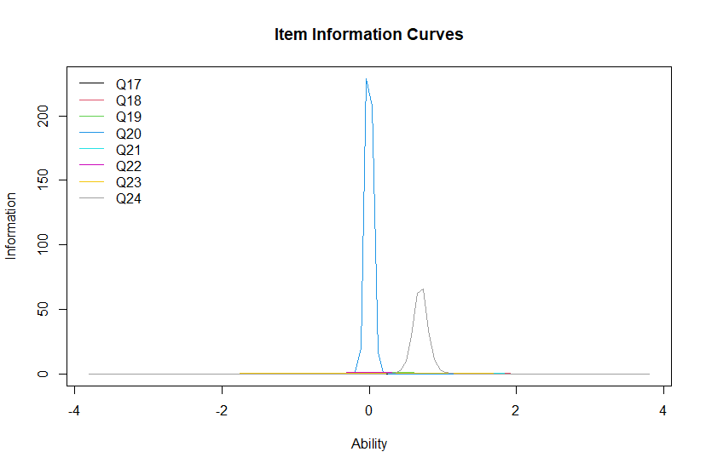
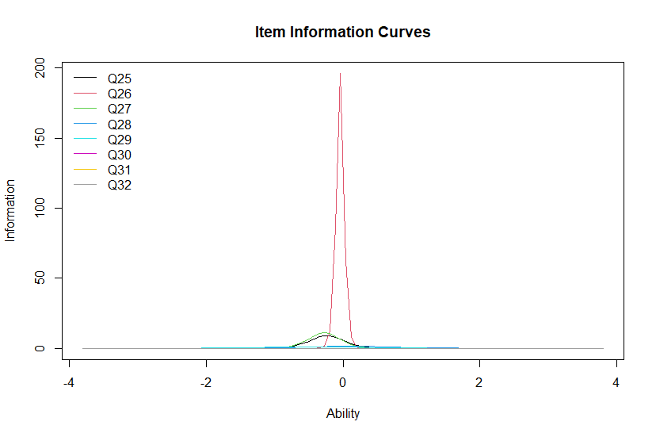
Appendix E. RStudio output plots

Slide 3
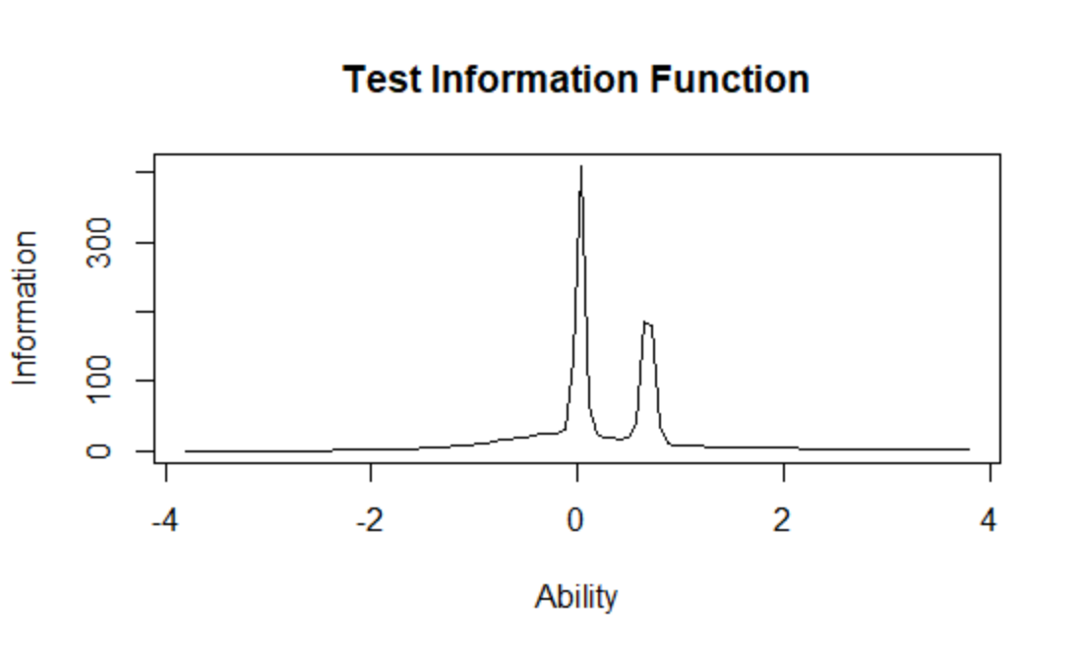
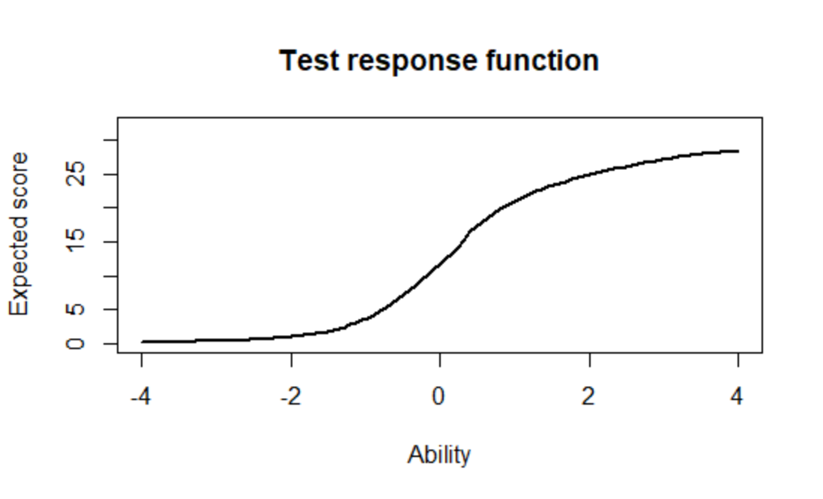
Appendix E. RStudio output plots

Slide 4
Total Information = 124.04 Information in (-3, 3) = 121.03 (97.57%) Based on all the items Unidimensionality check using Modified Parallel Analysis Alternative hypothesis: the second eigenvalue of the observed data is substantially larger than the second eigenvalue of data under the assumed IRT model Second eigenvalue in the observed data: 5.1875 Average of second eigenvalues in Monte Carlo samples: 5.6424 Monte Carlo samples: 100 p-value: 0.7228 Figure: RStudio output of unidimensionality check of the 32 questions.
Appendix E. RStudio output plots

