Slide 1
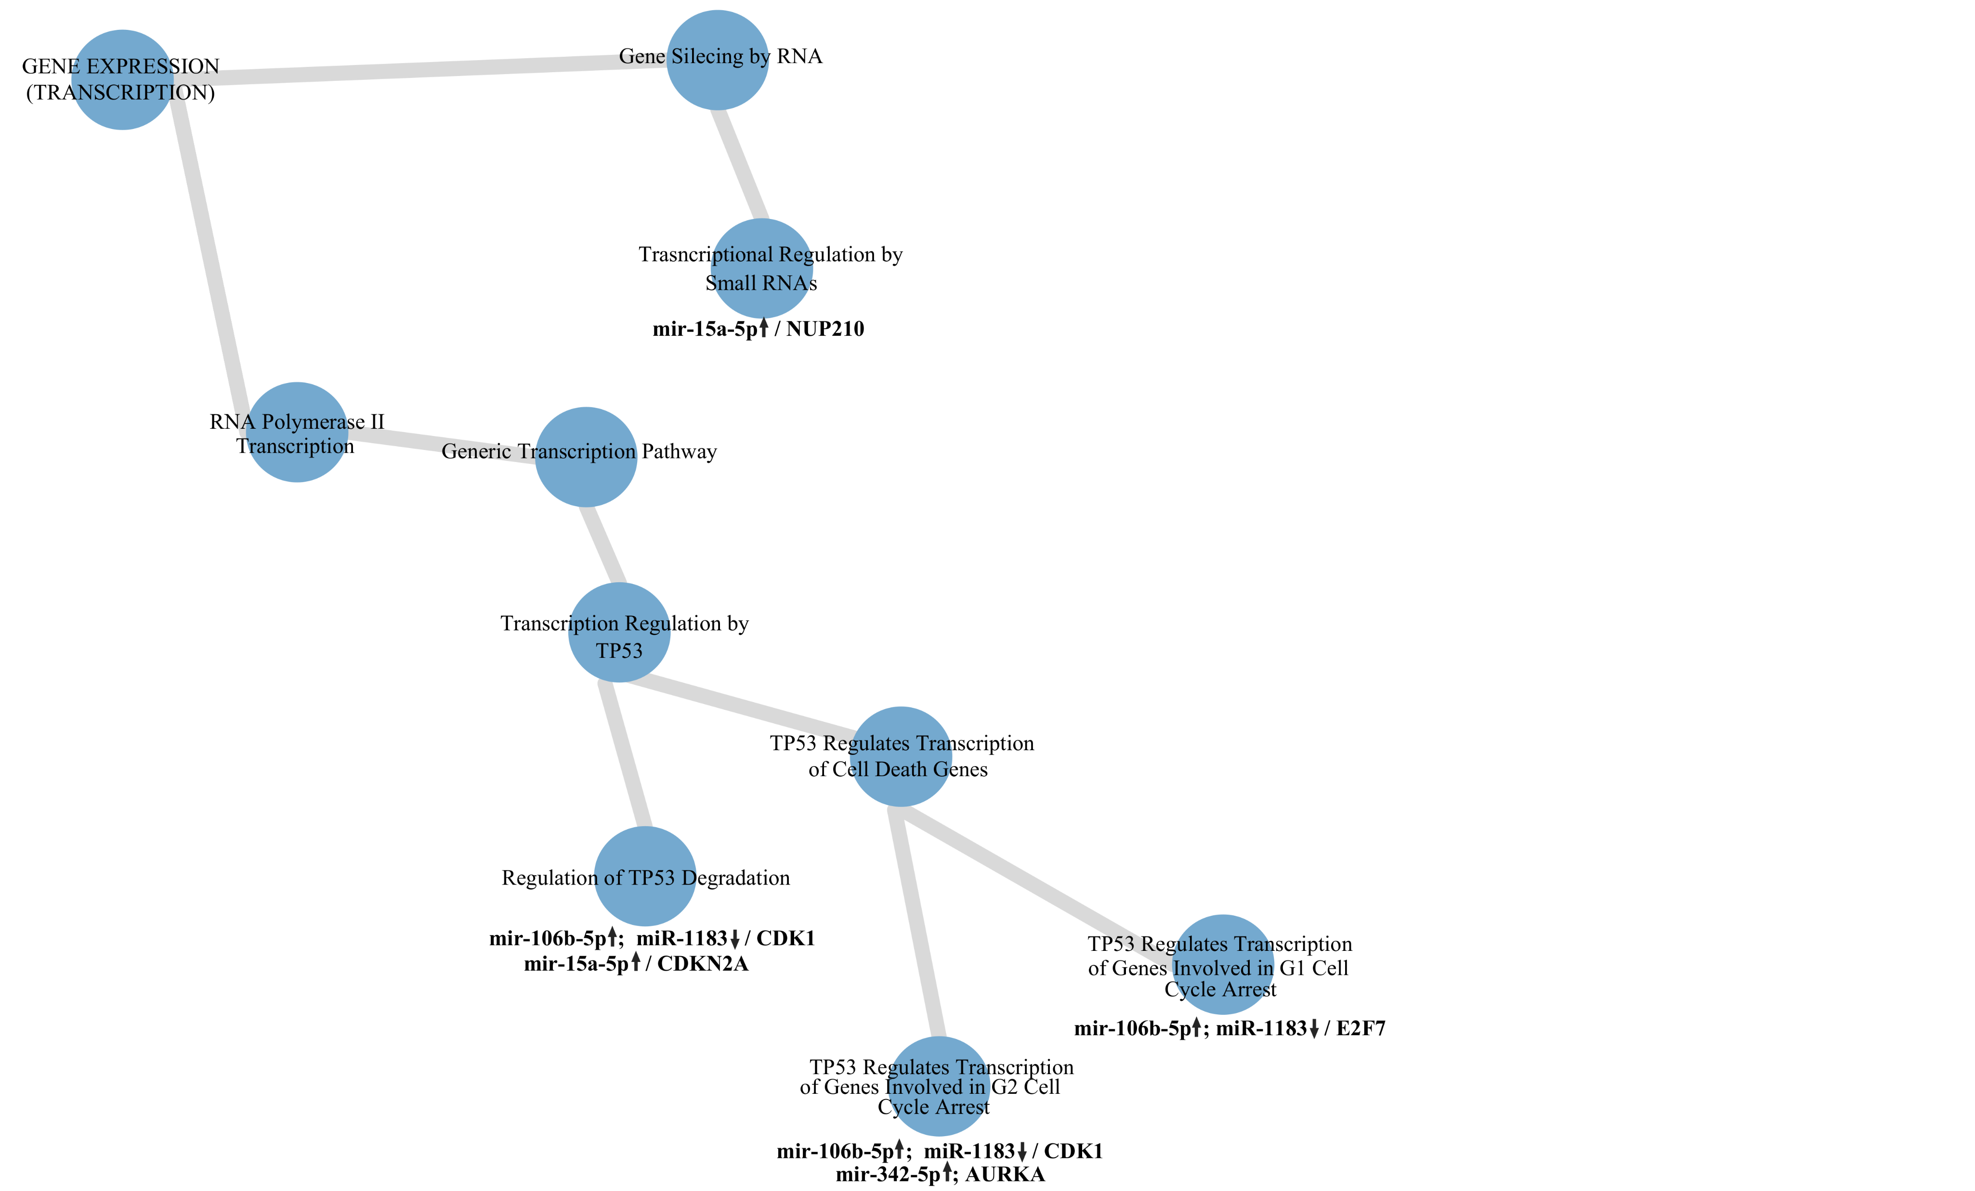
Supplementary figure 1. Network showing dysregulation in generics transcription pathways.
NUP210, nucleoporin 210; TP53, tumor protein p53; CDK1, cyclin dependent kinase 1; CDKN2A, cyclin-dependent kinase inhibitor 2A; AURKA, aurora kinase A; E2F7, E2F transcription factor 7

Slide 2
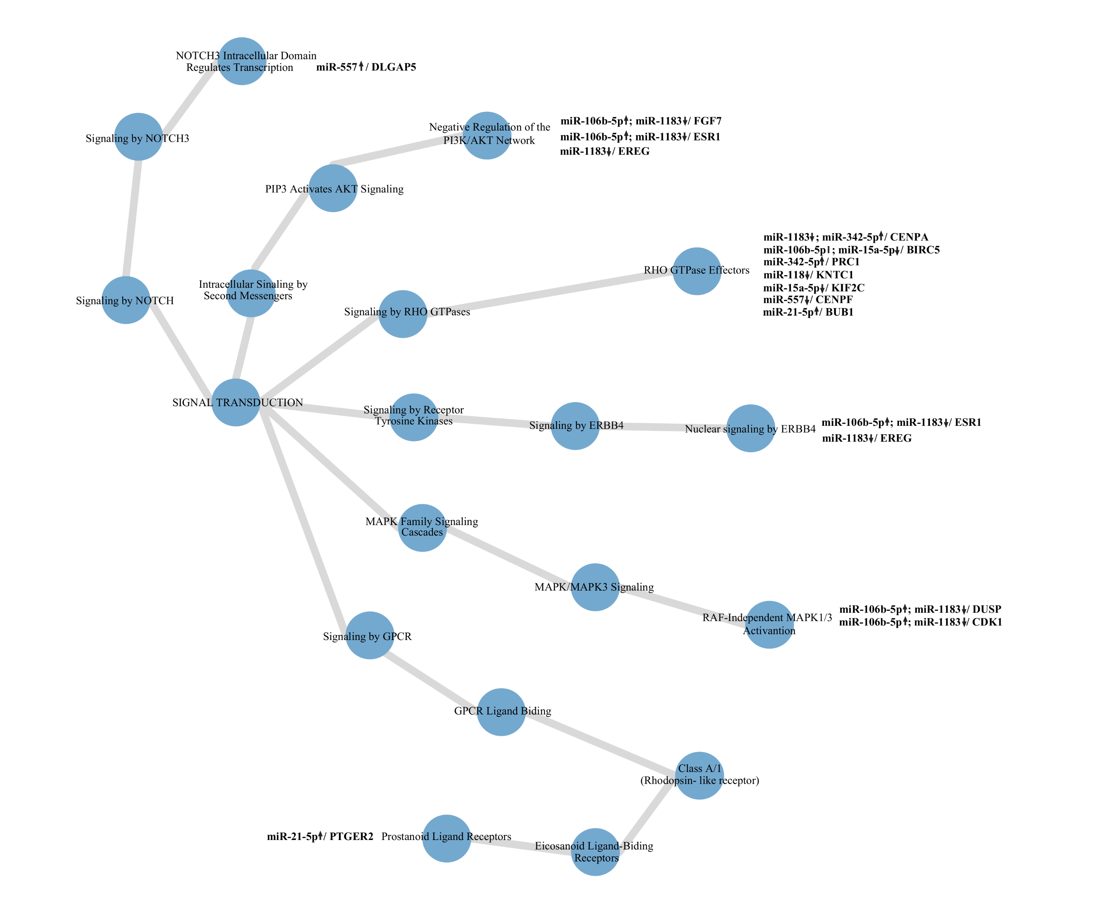
Supplementary figure 2. Networking showing dysregulation in signal transduction pathways
NOTCH, notch receptor; NOTCH3, notch receptor 3; PIP3, phosphatidylinositol-4,5-bisphosphate 3-kinase; AKT, protein kinase B; RHO GTPases, Rho family of GTPases; ERBB4, erb-b2 receptor tyrosine kinase 4; MAPK, mitogen-activated protein kinase; MAPK3, mitogen-activated protein kinase 3; GPCR, G protein-coupled receptor; DLGAP5, DLG associated protein 5; FGF7, fibroblast growth factor 7; ESR1, estrogen receptor 1
EREG, epiregulin; CENPA, centromere protein A; BIRC5, baculoviral IAP repeat containing 5; PRC1, protein regulator of cytokinesis 1; KNTC1, kinetochore-associated protein 1; KIF2C, kinesin family member 2C; CENPF, centromere protein F; BUB1, BUB1 mitotic checkpoint serine/threonine kinase; DUSP, dual specificity phosphatase; CDK1, cyclin dependent kinase 1; PTGER2, prostaglandin E receptor 2

Slide 3
Supplementary figure 3. Network showing dysregulation in metabolism proteins pathways.
SUMO E3, small ubiquitin-related modifier E3 ligase; IGF1, insulin like growth factor 1; CYR61, cysteine-rich angiogenic inducer 61; FBN1, fibrillin-1; DPP4, dipeptidyl peptidase 4; CDK1, cyclin dependent kinase 1; ESR1, estrogen receptor 1; BIRC5, baculoviral IAP repeat containing 5; DLT, denticleless; MITF, microphthalmia-associated transcription factor; CDKN2A, cyclin-dependent kinase inhibitor 2A; NUP210, nucleoporin 210; AURKA, aurora kinase A

Slide 4
Supplementary figure 4. Network showing dysregulation in metabolism of RNA pathways.
SLBP, stem-loop binding protein; NUP210, nucleoporin 210

Slide 5
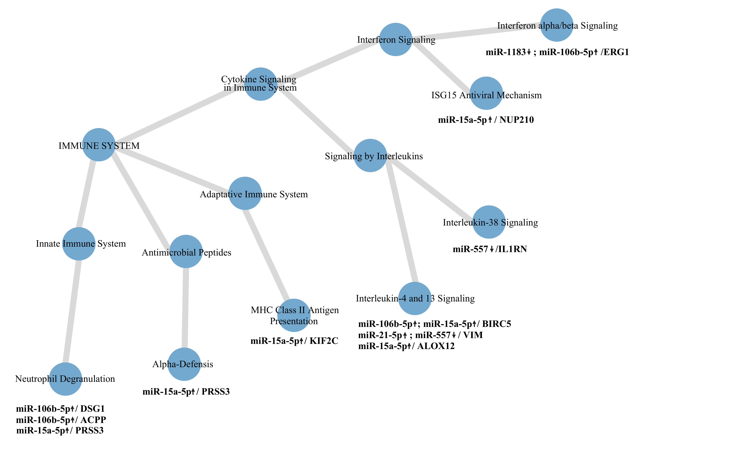
Supplementary figure 5. Network showing dysregulation in immune system pathways.
MHC Class II, major histocompatibility complex class II; ISG15, ISG15 ubiquitin-like modifier; NUP210, nucleoporin 210; ERG1, early growth response 1; IL1RN, interleukin 1 receptor antagonist; BIRC5, baculoviral IAP repeat containing 5; VIM, vimentin; ALOX12, arachidonate 12-lipoxygenase, 12S type; KIF2C, kinesin family member 2C; PRSS3, serine protease 3; DSG1, desmoglein 1; ACPP, prostatic acid phosphatase

Slide 6
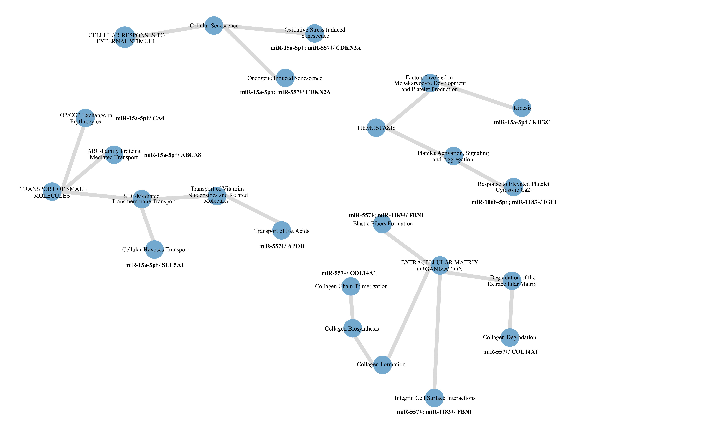
Supplementary figure 6. Network showing dysregulation in transport of small molecules, cellular responses to external stimuli, hemostasis and extracellular matrix organization pathways.
CDKN2A, cyclin-dependent kinase inhibitor 2A; KIF2C, kinesin family member 2C; IGF1, insulin like growth factor 1; CA4, carbonic anhydrase 4; ABCA8, ATP binding cassette subfamily A member 8; SLC5A1, solute carrier family 5 member 1; APOD, apolipoprotein D; FBN1, fibrillin-1; COL14A1, collagen type XIV alpha 1 chain

Slide 7
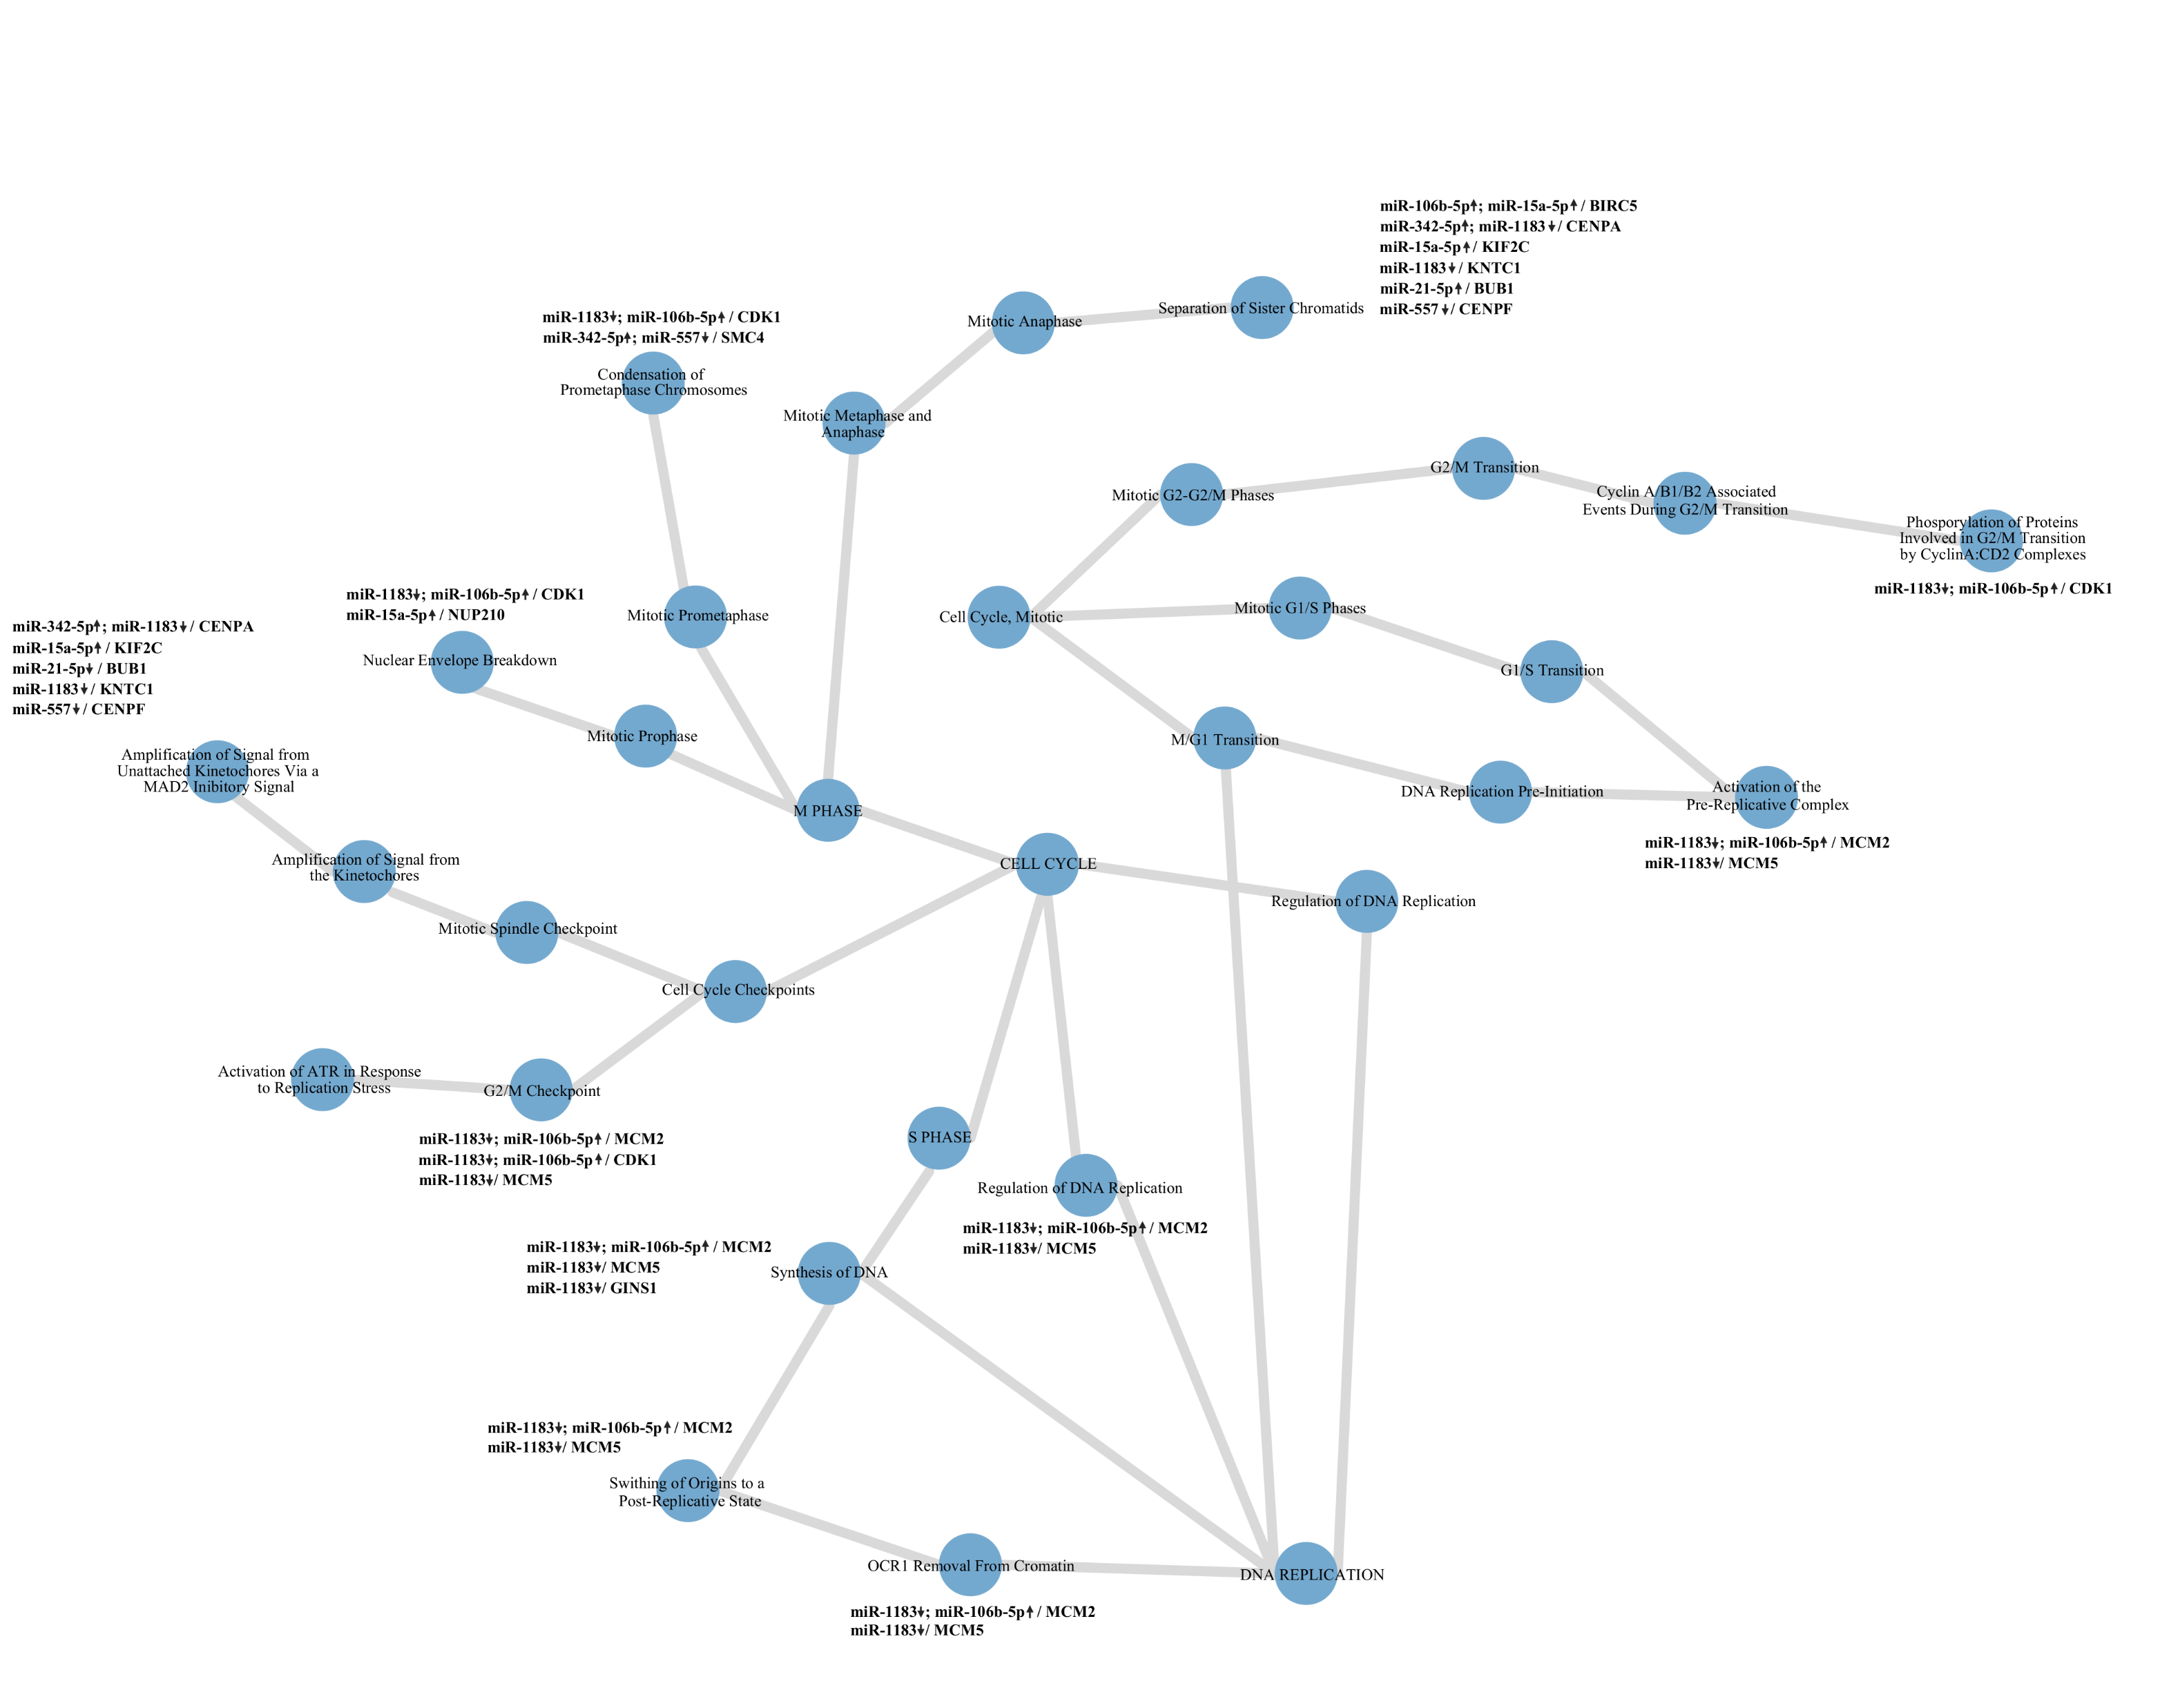
Supplementary figure 7. Network showing dysregulation in cell cycle pathways.
MAD2, mitotic arrest deficient 2; ATR, ataxia telangiectasia and Rad3 related; OCR1, ovarian cancer-related protein 1; CENPA, centromere protein A; KIF2C, kinesin family member 2C; BUB1, BUB1 mitotic checkpoint serine/threonine kinase; KNTC1, kinetochore-associated protein 1; CENPF, centromere protein F; CDK1, cyclin dependent kinase 1; NUP210, nucleoporin 210; SMC4, structural maintenance of chromosomes 4; BIRC5, baculoviral IAP repeat containing 5; MCM2, minichromosome maintenance complex component 2; MCM5, minichromosome maintenance complex component 5; GINS1, GINS complex subunit 1

Slide 8
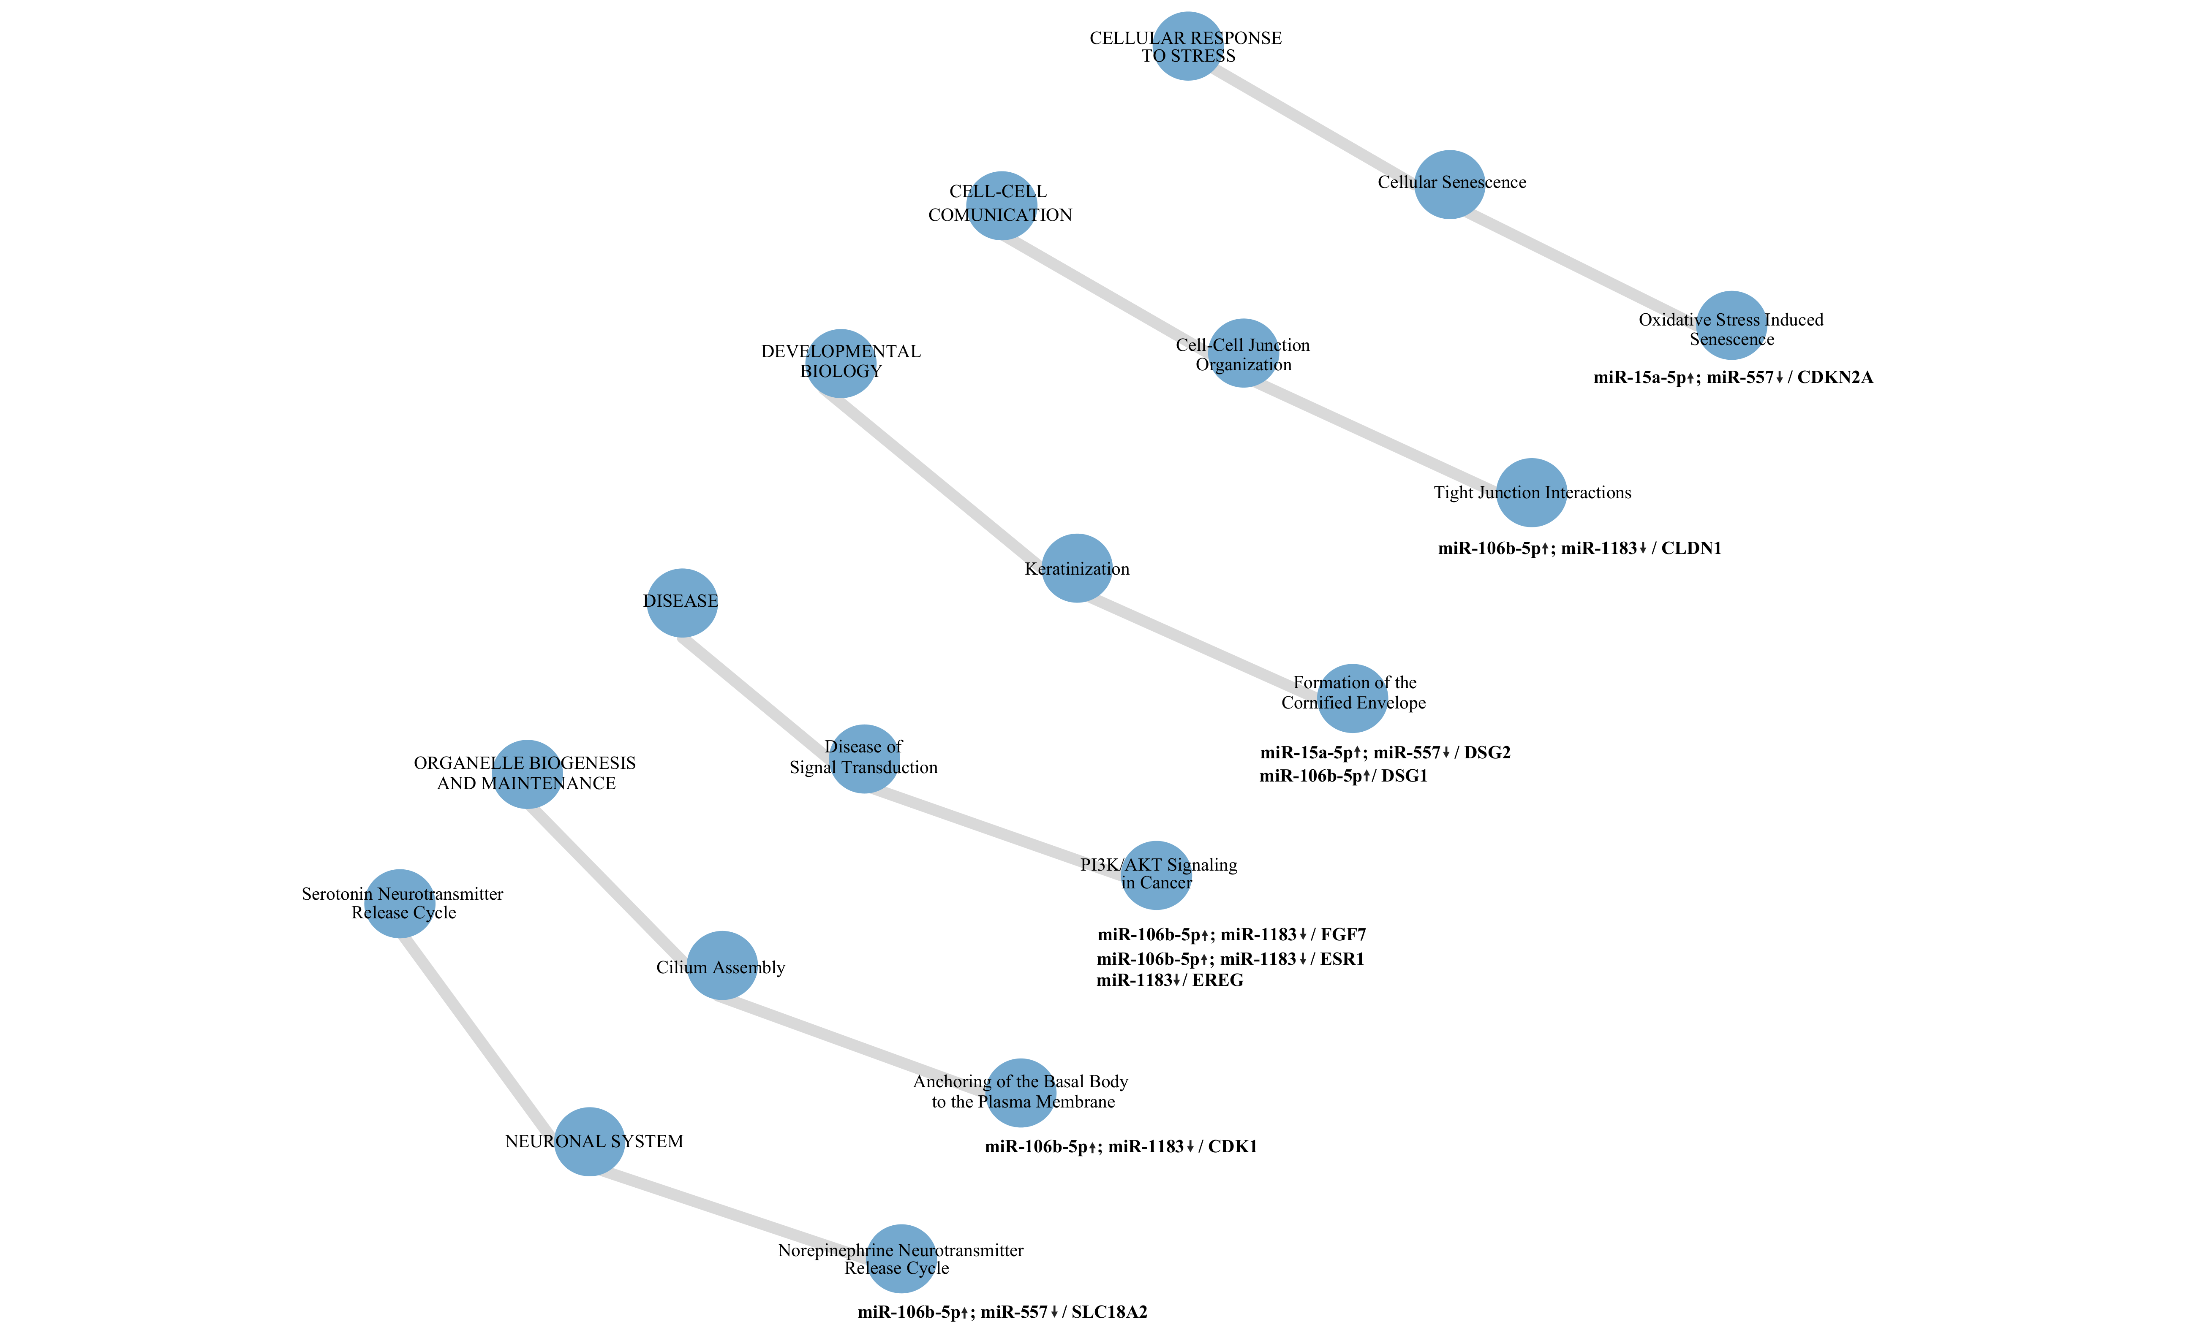
Supplementary figure 8. Network showing dysregulation in neural system, cilium assembly, diseases of signal transduction, keratinization, cell-cell junction organization and cellular senescence pathways.
PI3K, phosphoinositide 3-kinase; AKT, protein kinase B; CDKN2A, cyclin-dependent kinase inhibitor 2A; CLDN1, claudin 1; DSG2, desmoglein 2; DSG1, desmoglein 1; FGF7, fibroblast growth factor 7; ESR1, estrogen receptor 1; EREG, epiregulin; CDK1, cyclin dependent kinase 1; SLC18A2, solute carrier family 18 member A2

Slide 9
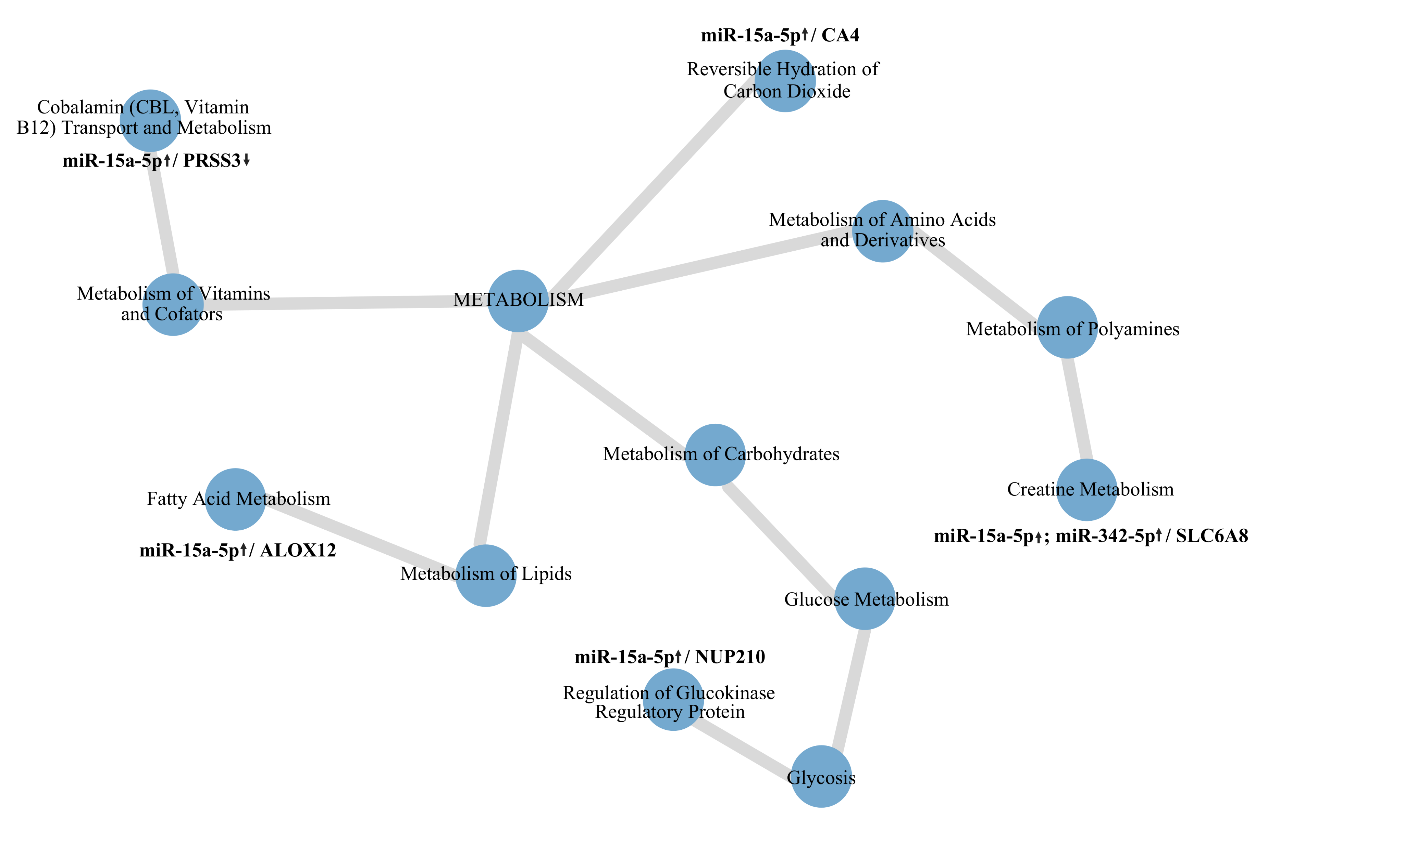
Supplementary figure 9. Network showing dysregulation in metabolism pathways.
PRSS3, serine protease 3; ALOX12, arachidonate 12-lipoxygenase, 12S type; CA4, carbonic anhydrase 4; NUP210, nucleoporin 210; SLC6A8, solute carrier family 6 member 8

