Slide 1
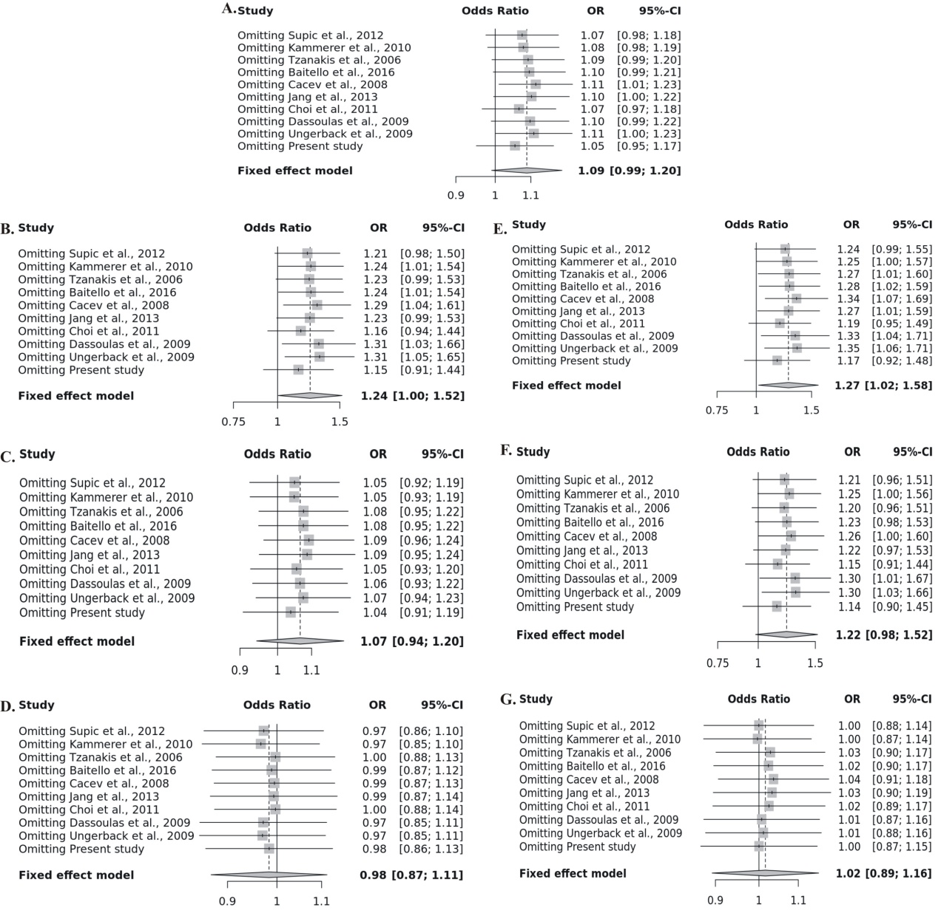
Supplementary Figure 1. Sensitivity analysis for VEGF-116G/A polymorphism (A.) Allele contrast (B.) Recessive (C.) Dominant (D.) Over dominant (E.) AA vs GG (F.) AA vs AG and (G.) AG vs GG

