Slide 1
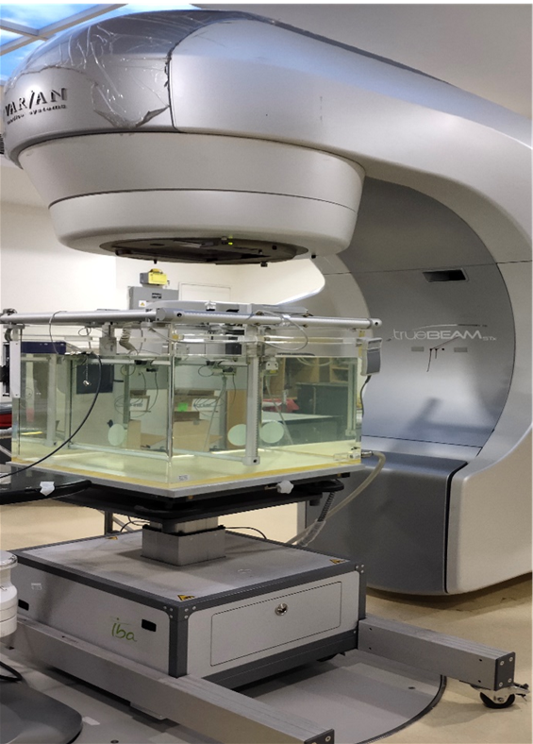
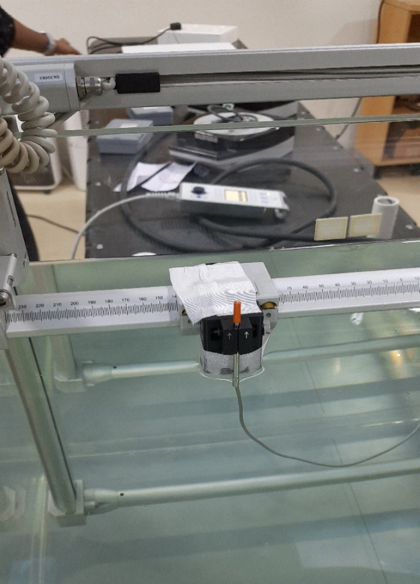
Suppl figure. 1 (a) RFA Setup in Linac for PDD Measurement. Suppl figure. 1 (b) RAZOR Chamber in Vertical Position in RFA for PDD measurement
1 (a)
1 (b)

Slide 2
Figure.2S (a) TLD placed inside the Rando Phantom. Figure. 2S(b) Position of the Rando Phantom in the Linac Couch. Figure2S (c) CBCT Image of Rando Phantom

