Slide 1
Supplementary Files
Figures

Slide 2
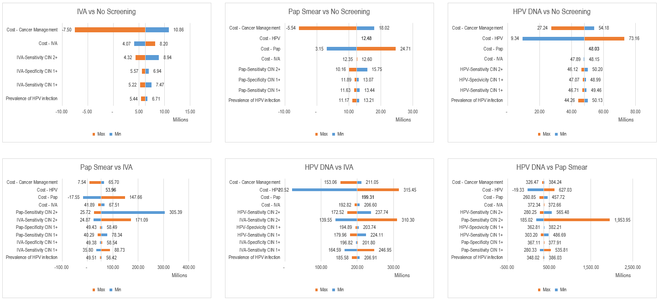
Currency in IDR (Indonesian Rupiah)
Figure 1 Tornado Diagram of One Way Analysis for Screening Modalities Every 3 Years

Slide 3
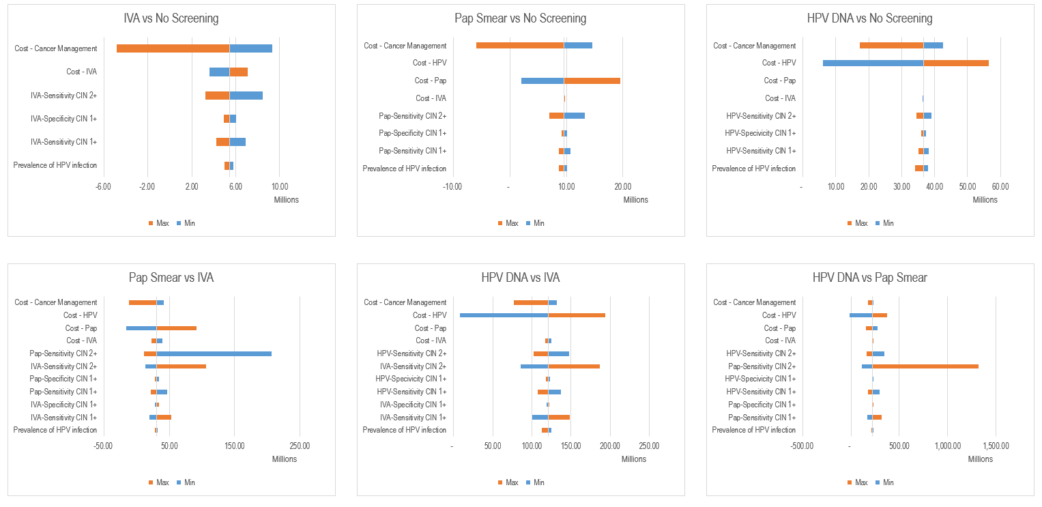
Currency in IDR (Indonesian Rupiah)
Figure 2 Tornado Diagram of One Way Analysis for Screening Modalities Every 5 Years

Slide 4
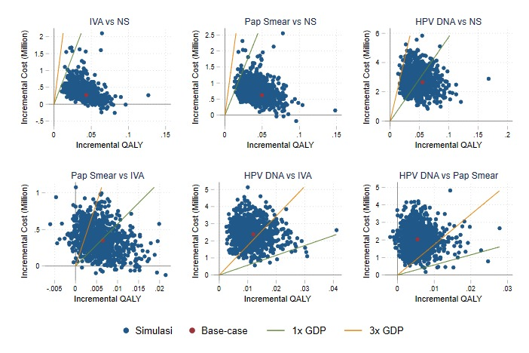
Figure 3 Probabilistic Sensitivity Analysis Every 3 Years

Slide 5
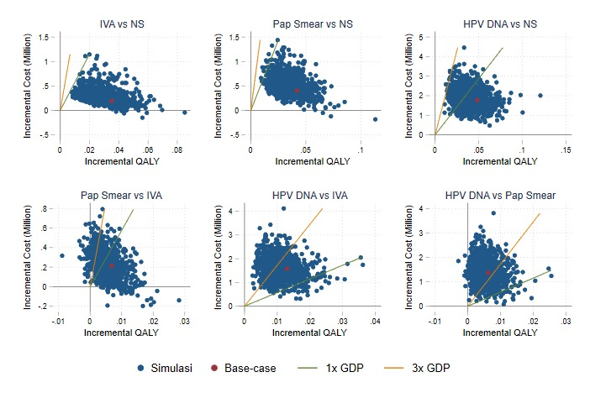
Figure 4 robabilistic Sensitivity Analysis Every 5 Years

Slide 6
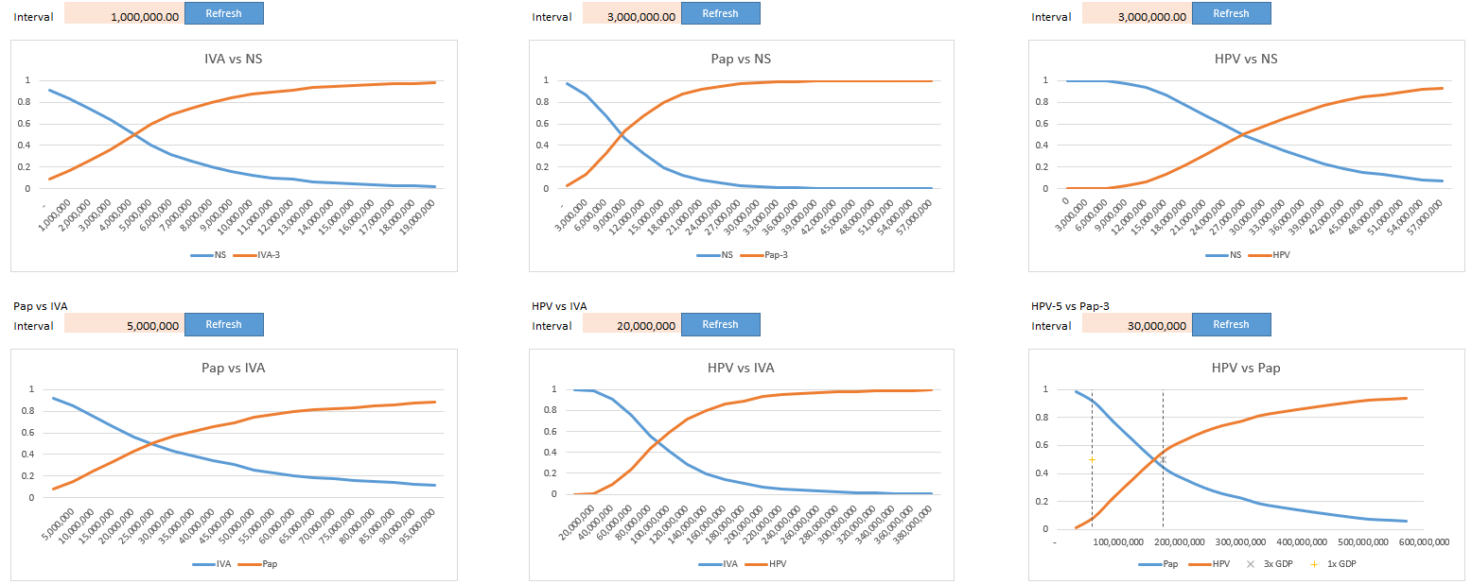
Currency in IDR (Indonesian Rupiah)
Figure 5 Cost-Effectiveness Acceptability Curve

