Slide 1
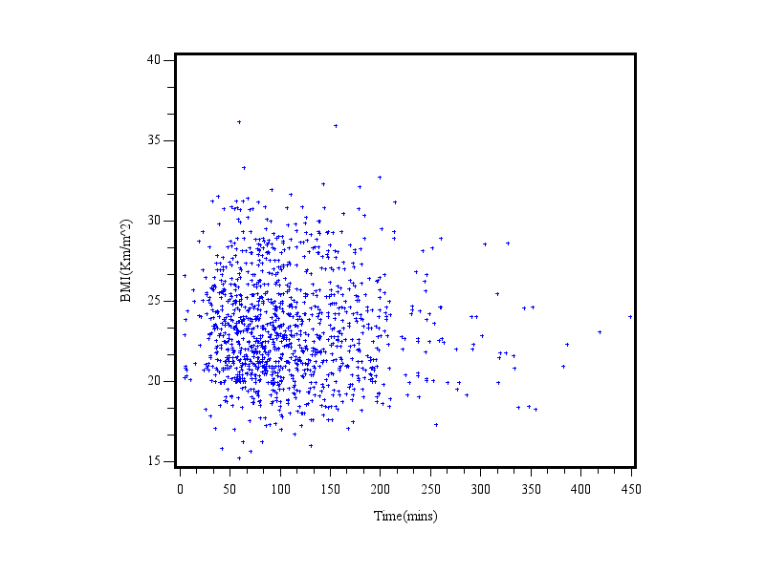
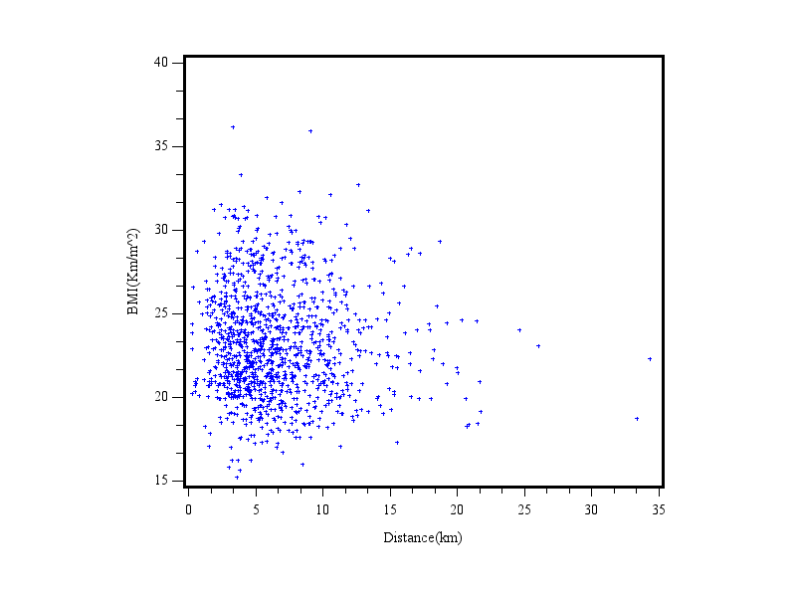
Figure S1. Correlation between smartphone monitored physical activity and BMI. (A) Plot of average daily physical activity time and BMI (R²=0.002, P=0.1031). (B) Plot of average daily physical activity distance and BMI (R²=0.002, P=0.1160).
A
B

