Slide 1
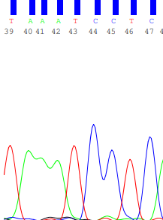
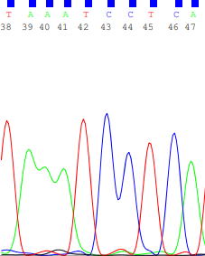
Supplementary Figure 1
A
B
Supplementary Figure 1: A representative electropherogram of an OSCC patient sample (A) and control sample (B) for USP9X exon 6. The encircled base shows the target SNP.

Slide 2
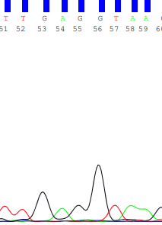
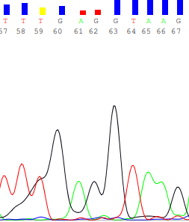
Supplementary Figure 2
A
B
Supplementary Figure 2: A representative electropherogram of an OSCC patient sample (A) and control (B) for USP9X Intron between exon13 and 14. The encircled base is the target SNP.

Slide 3
Supplementary Figure 3
Supplementary Figure 3: A representative electropherogram of an OSCC patient sample (A) and control (B) for USP9X exon 29. The circled base is the target SNP.

Slide 4
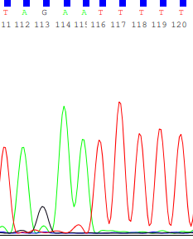
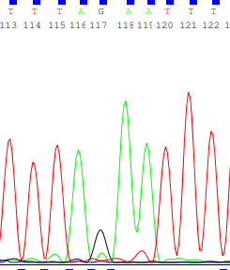
Supplementary Figure 4
A
B
Supplementary Figure 4: A representative electropherogram of an OSCC patient sample (A) and control (B) for USP9X Exon 33. The circled base is the target SNP

Slide 5
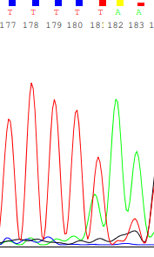
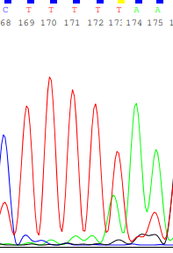
Supplementary Figure 5
A
B
Supplementary Figure 5: A representative electropherogram of patient sample (A) and control (B) for USP9X Exon 37. The highlighted base is identical in A and B, indicating the absence of polymorphism in the patient sample.

Slide 6
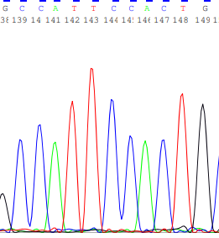
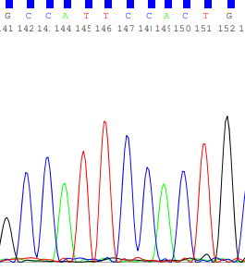
Supplementary Figure 6
A
B
Supplementary Figure 6: A representative electropherogram of an OSCC patient sample (A) and control (B) for USP9X Exon 43. The circled base is the target nucleotide. Shown here is the reverse complement of the original sequence.

Slide 7
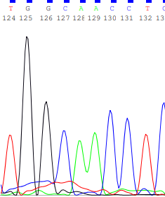
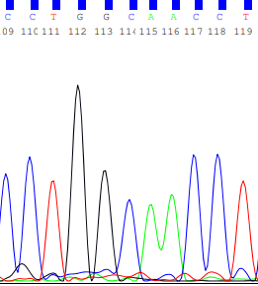
Supplementary Figure 7
A
B
Supplementary Figure 7: A representative electropherogram of an OSCC patient sample (A) and control (B) for DDX3X Exon 17. The highlighted region shows the absence of single nucleotide polymorphism at the target base.

