Slide 1
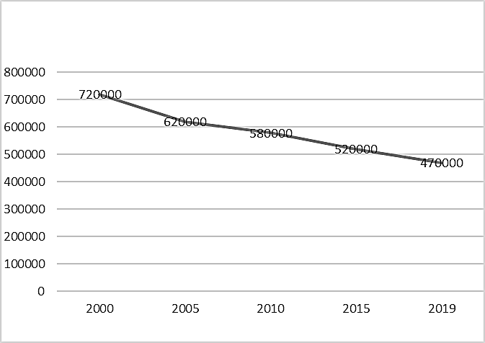
Number of people (all ages) living with HIV
Year
Supplementary Figure 1
Trend of estimated ART coverage among people living with HIV in Thailand from 2005 to 2019

Slide 2
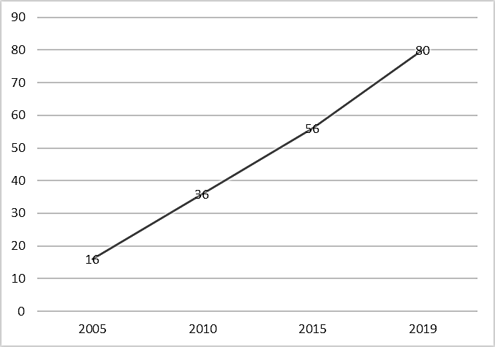
ART coverage among people living with HIV (%)
Year
Supplementary Figure 2
Trend of estimated number of people living with HIV (all ages) HIV in Thailand from 2000 to 2019

