Slide 1
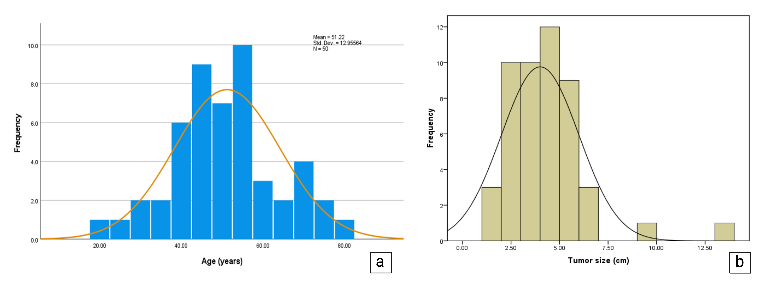
Figure S1| The age distribution (a) and tumor size distribution (b) among the studied patients.

Slide 2
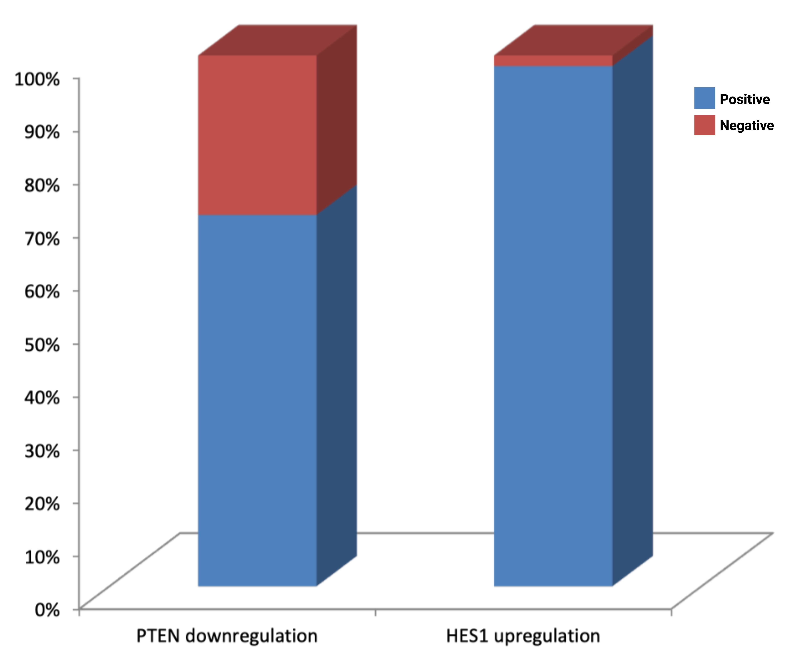
Figure S2| The alterations in gene expression for PTEN and HES1.

Slide 3
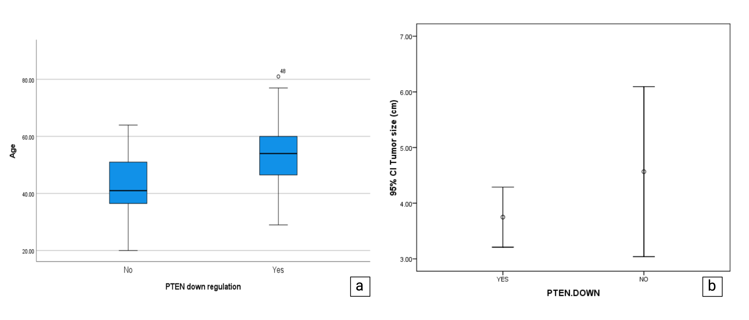
Figure S3| The mean age (a) and mean tumor size (b) in groups with and without PTEN expression changes.

Slide 4
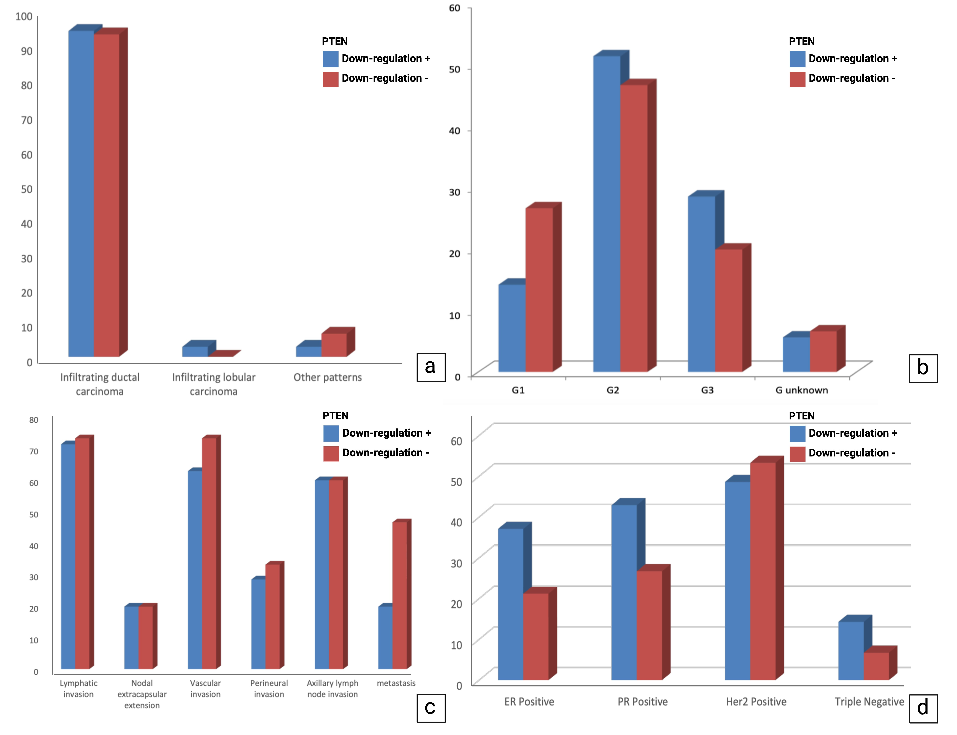
Figure S4| Distribution of histological patterns (a), tumor grades (b), tissue invasion (c), and hormonal profile status (d) of tumors in groups with and without reduced PTEN expression.

Slide 5
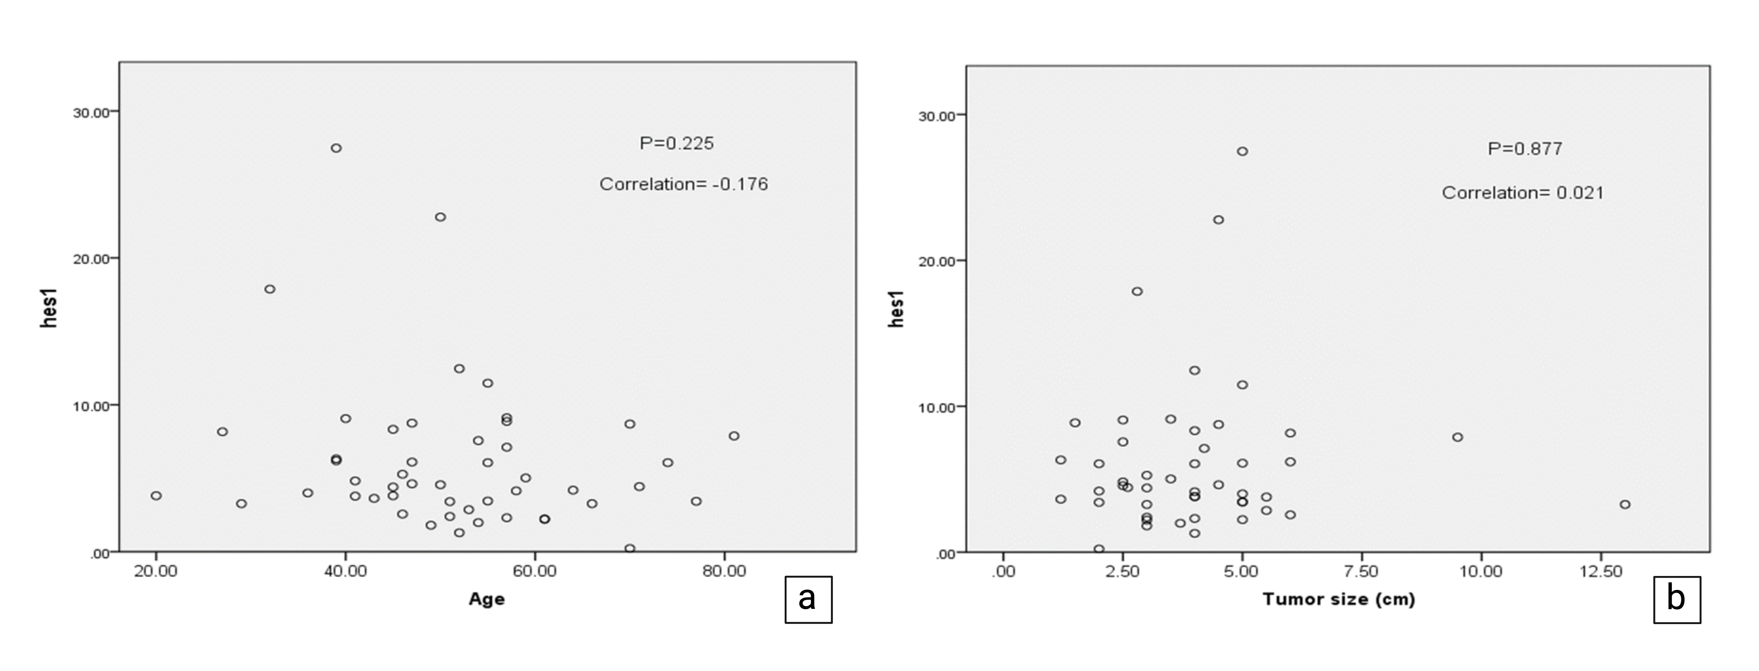
Figure S5| The correlation between age (a) and tumor size (b) with HES1 expression levels.

Slide 6
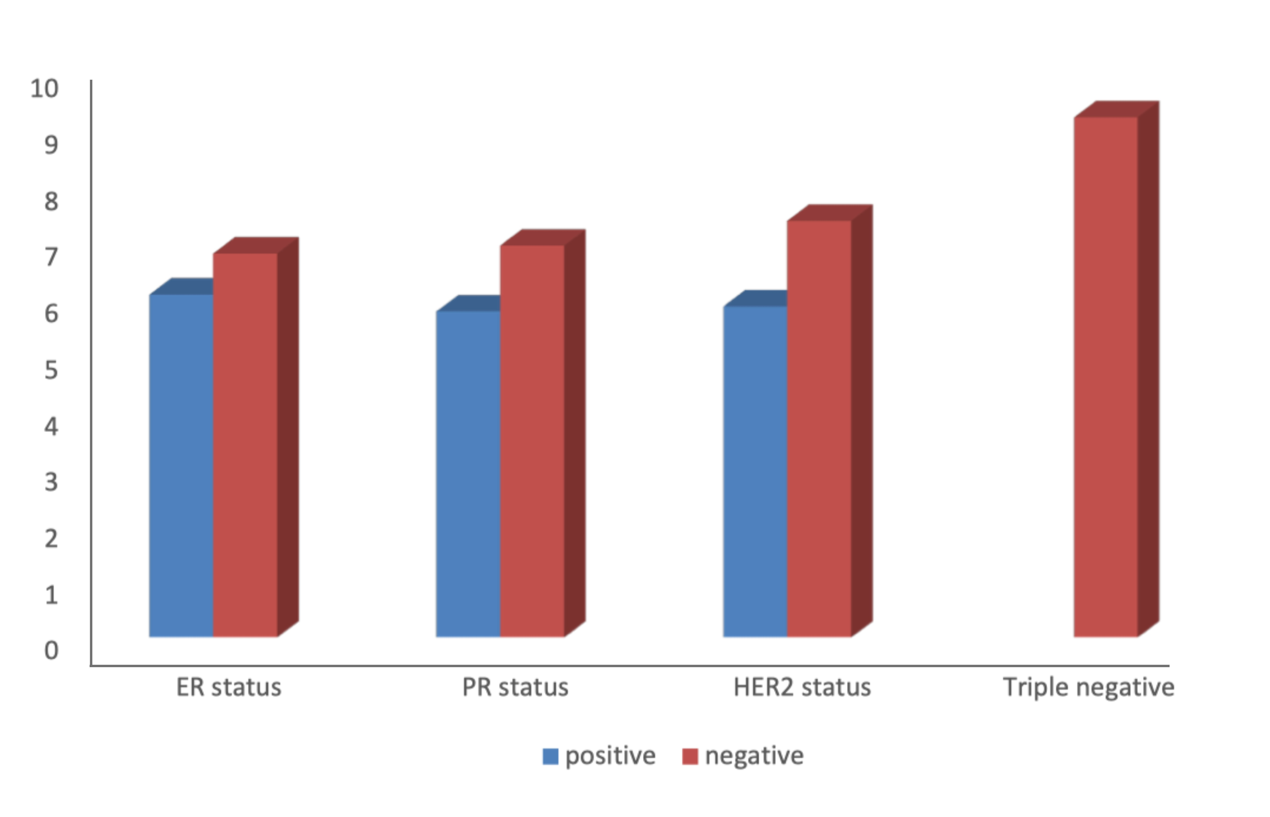
Figure S6| The correlation between average HES1 expression intensity, hormonal profile, and HER2 status.

