Slide 1
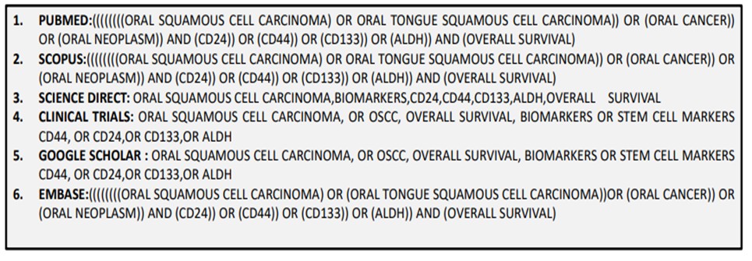
Supplementary Figures
Figure S1: Literature Search terms

Slide 2
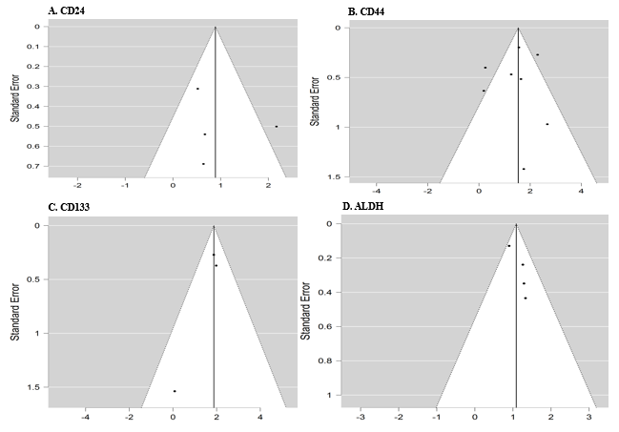
Figure S2: Figure illustrating the funnel plot of 3-year overall survival rates for cancer stem cell marker A. CD24; B. CD44; C.CD133; D. ALDH

Slide 3
Figure S1 : Search strategies used in different databases (PubMed, Scopus, Science Direct, Clinical Trials, Google Scholar, EMBASE) for studies on oral squamous cell carcinoma, biomarkers (CD24, CD44, CD133, ALDH), and overall survival.
Figure S2 : Funnel plots for markers A) CD24, B) CD44, C) CD133, and D) ALDH, showing standard error against effect size, suggestive of possible publication bias .

