Slide 1
Supplementary figure 1: Flow diagram for enrolment of study participants.
522 were >50 years on their second colonoscopy.
1371 participants aged <50 years were enrolled into the surveillance program during the study period.
202 had a medical history of IBD.
132 had CRC.
959 cases were excluded
52 had hereditary CRC syndromes.
26 had incomplete index colonoscopies.
412 cases met study eligibility criteria and were included in this study.
12 had no clinical reports.
824 controls were randomly selected matching for sex, and who had at least 2 colonoscopies in the same time period.
13 had no follow-up colonoscopy.

Slide 2
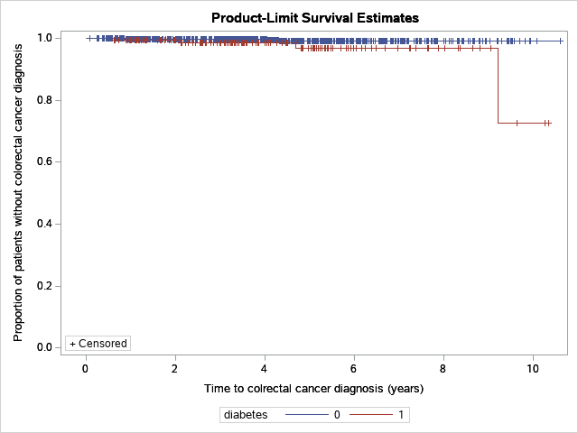
Supplementary figure 2: Kaplan-Meier curves for time measured from the index colonoscopy to CRC diagnosis during surveillance versus Diabetes ( Yes, No).
No
Yes

