Slide 1
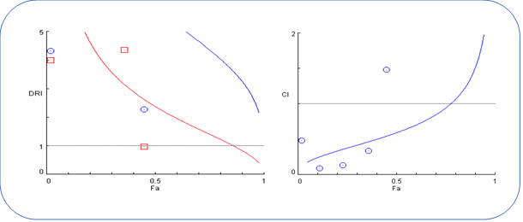
Supplementary Figure (1): combination index plot (right) and dose reduction index plot (left) for the mixture at 24 hrs.

Slide 2
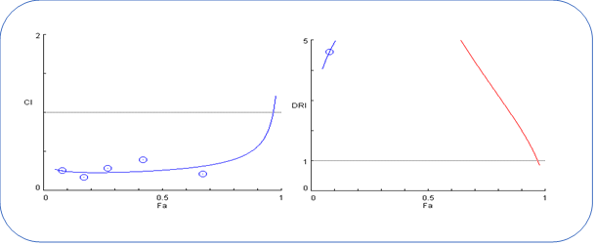
Supplementary Figure (2): combination index curve (left) and dose reduction index curve (right) for the mixture at 72 hrs.

Slide 3
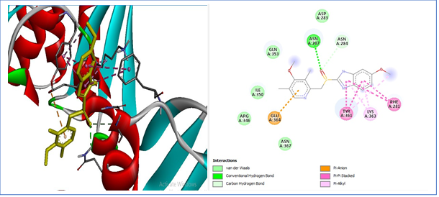
Supplementary Figure (3): human Hsp60 binding site with omeprazole

Slide 4
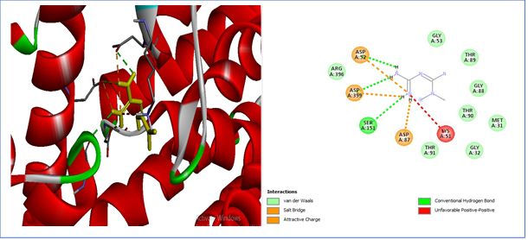
Supplementary Figure (4): human Hsp60 binding site with metformin

Slide 5
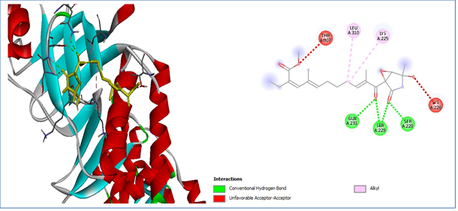
Supplementary Figure (5): human Hsp60 binding site with Epolactaene

Slide 6
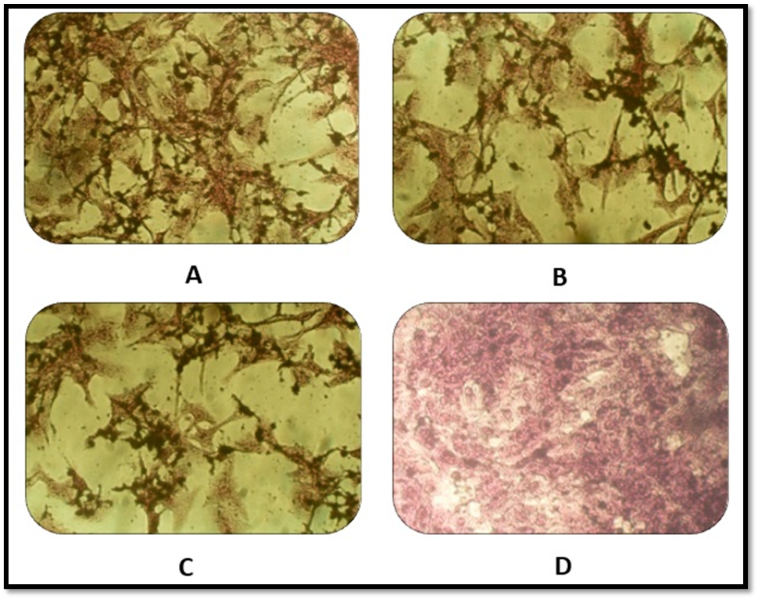
Supplementary Figure (6): morphology of Hela cancer cells. (A) Cancer cells were exposed to 1000 µg/ml of metformin for 72 hours. (B) Cancer cells were exposed to 1000 µg/ml of omeprazole concentration for 72 hours. (C) The cancer cells were subjected to a 1000 µg/ml concentration of a combination of metformin and omeprazole for 72 hours. (D) The cervical cancer cells were left untreated and used as the control group.

