Slide 1
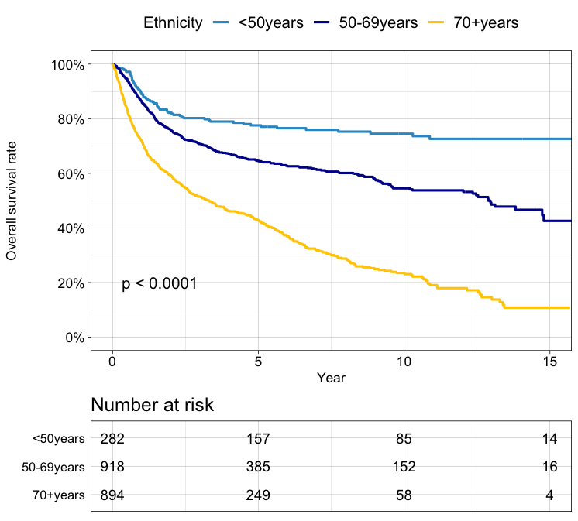
Supplementary Graph 1. Kaplan-Meier plots of survival analysis for OCSCC by age group

Slide 2
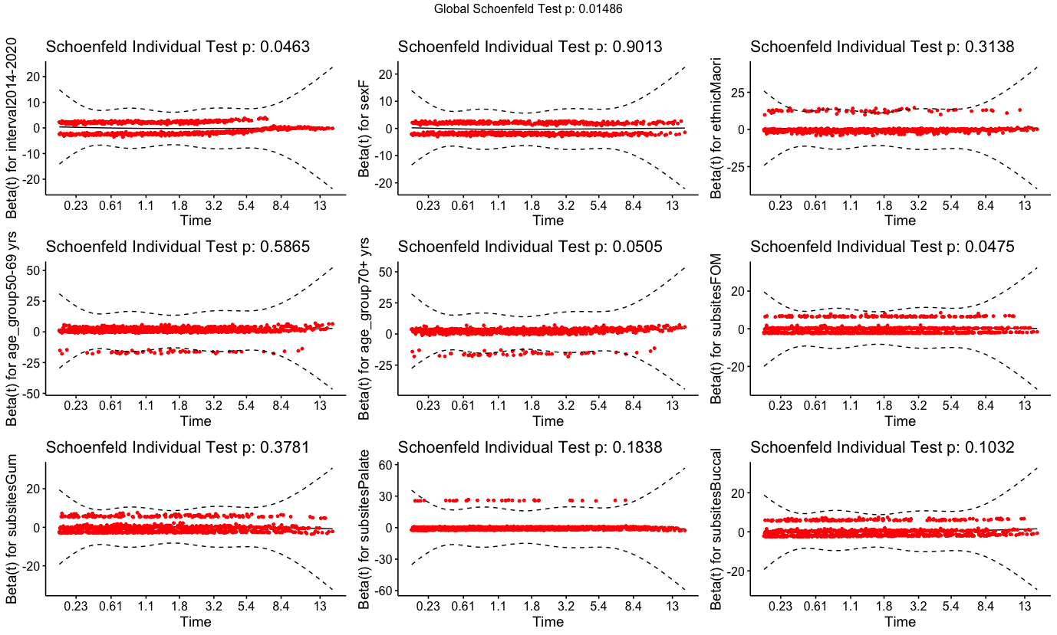
Supplementary Graph 2. Global Schoenfield tests

