Slide 1
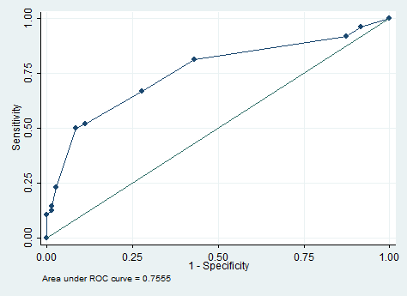
Appendix Subgroup analysis of gland involvement group (ROC)

