Slide 1
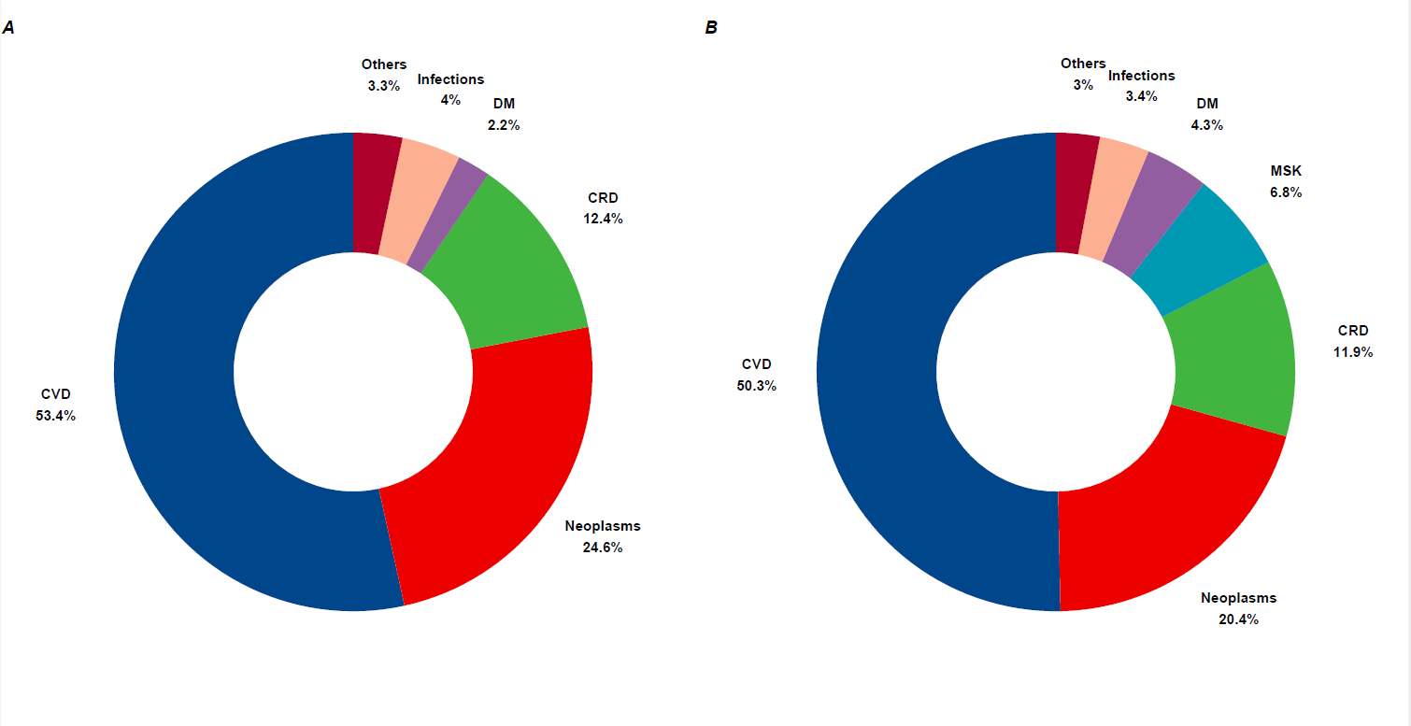
Figure 1s. Donut charts showing the proportions of all smoking-associated (A) deaths and (B) DALYs; with diabetes and kidney diseases (DM), musculoskeletal disorders (MSK), chronic respiratory diseases (CRD), and cardiovascular diseases (CVD).

Slide 2
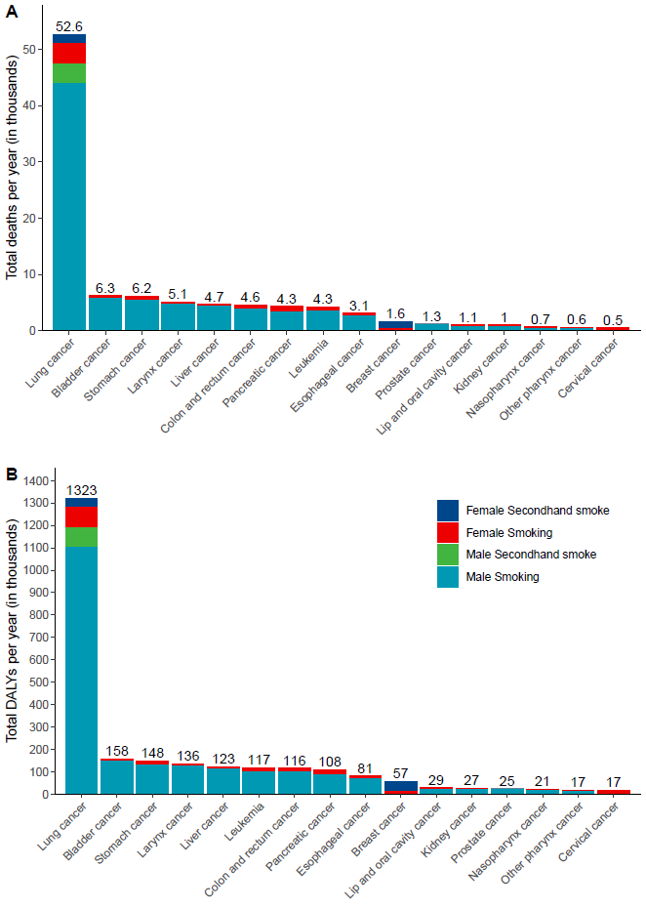
Figure 2s. Bar graphs illustrating the frequency of (A) total deaths and (B) disability-adjusted life years (DALYs) attributed to various neoplasms in the MENA region, based on the GBD study's 2019 estimates; total estimates, expressed in thousands, are displayed above each bar; the term "lung cancer" is used to represent tracheal, bronchus, and lung cancers.

Slide 3
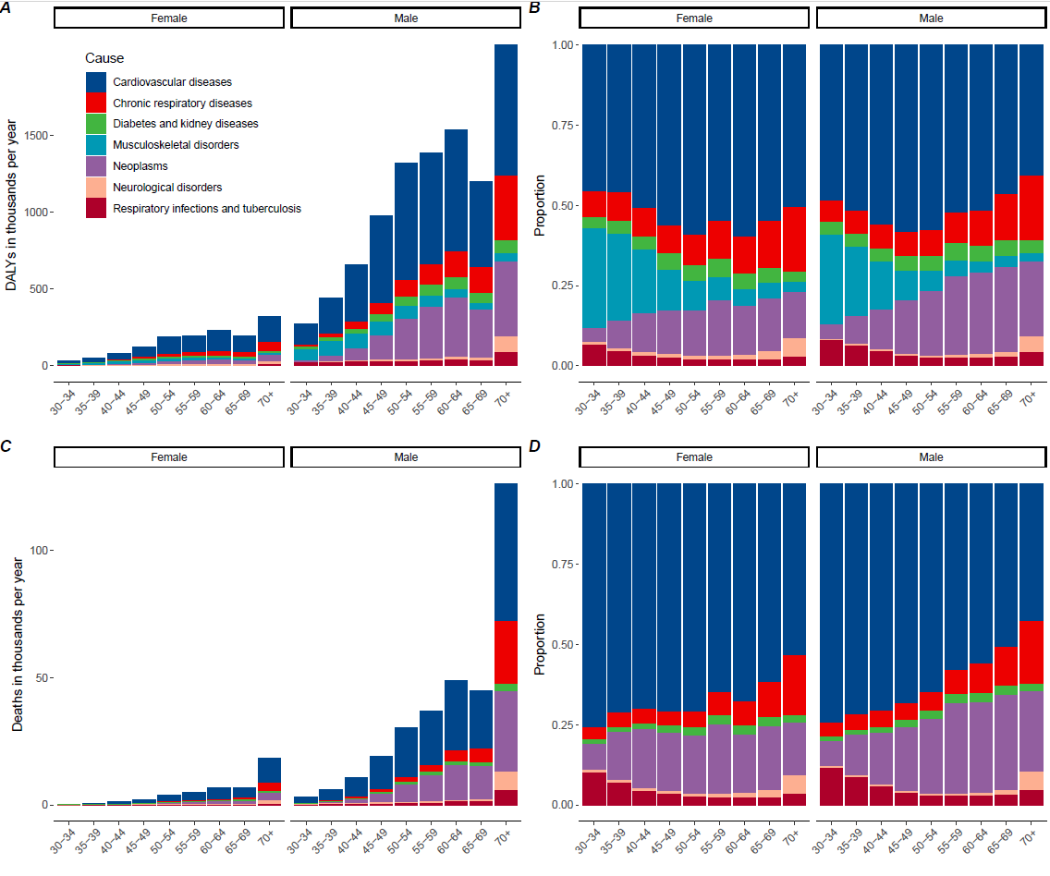
Figure 3s. Bar graphs showing the distribution of smoking-related burden by age group in the MENA region for females and males; panels show the (A) number of DALYs, (B) proportion of DALYs, (C) number of deaths, and (D) proportion of deaths per age group.

Slide 4
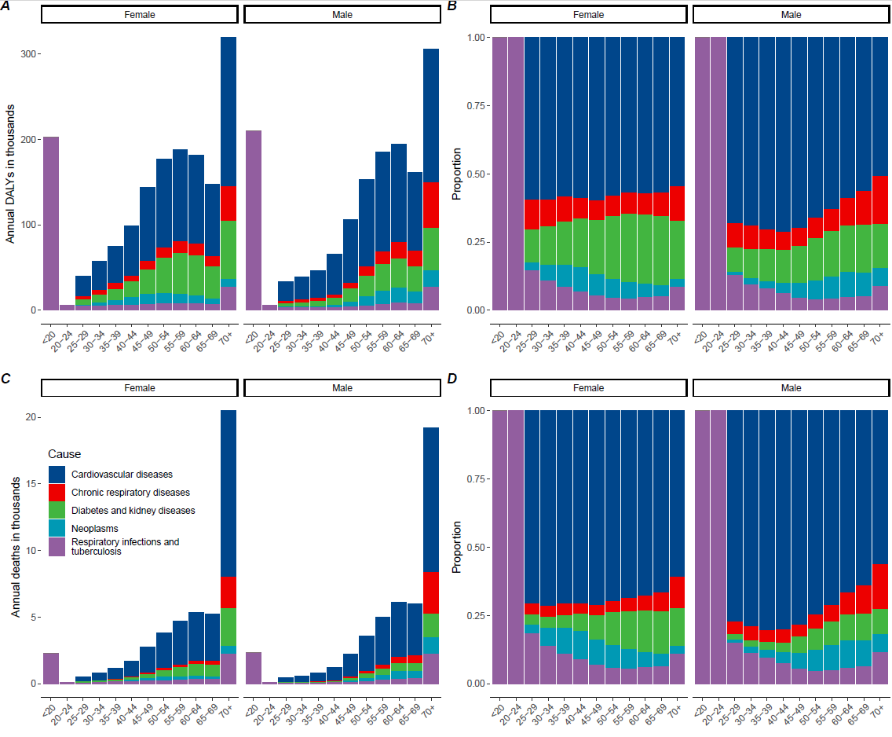
Figure 4s. Bar graphs showing the distribution of second-hand smoking–related burden by age group in the MENA region for females and males; panels show the (A) number of DALYs, (B) proportion of DALYs, (C) number of deaths, and (D) proportion of deaths per age group.

