Slide 1
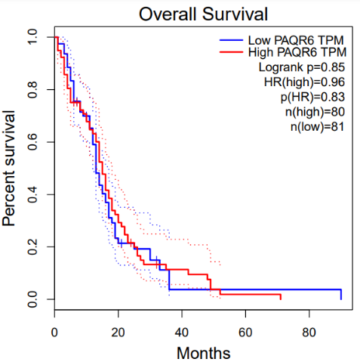
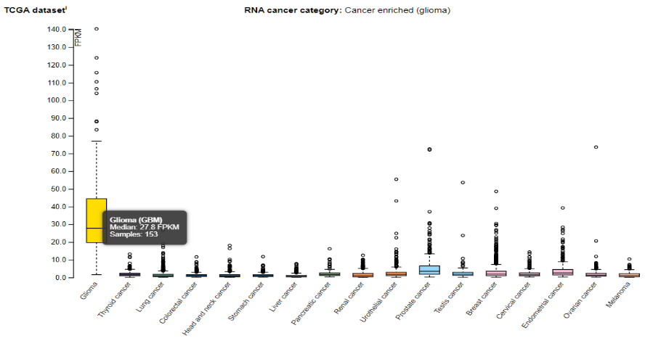
Supplementary Figure 6. Results of survival analysis with GEPIA (left) and RNA expression from the Human Protein Atlas database on PAQR6 (right)

Slide 2
Supplementary Figure 7. IP metabolism involving the ITPKB gene (red arrow)

Slide 3
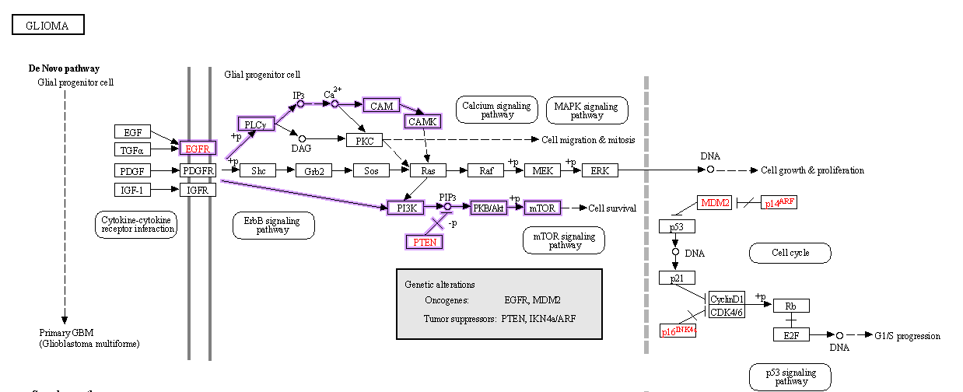
Supplementary Figure 8. Signaling analysis in KEGG related to calcium signaling in glioma involving IP compounds, where the metabolism of IP compounds is regulated by ITPKB (KEGG, 2023) (pathway marked in purple)

Slide 4
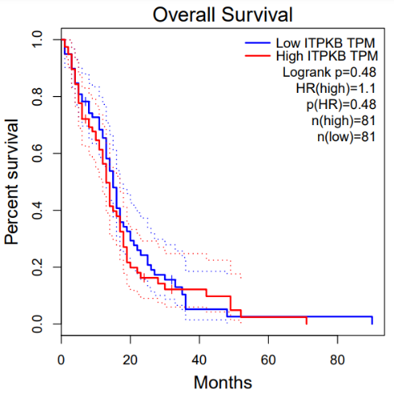
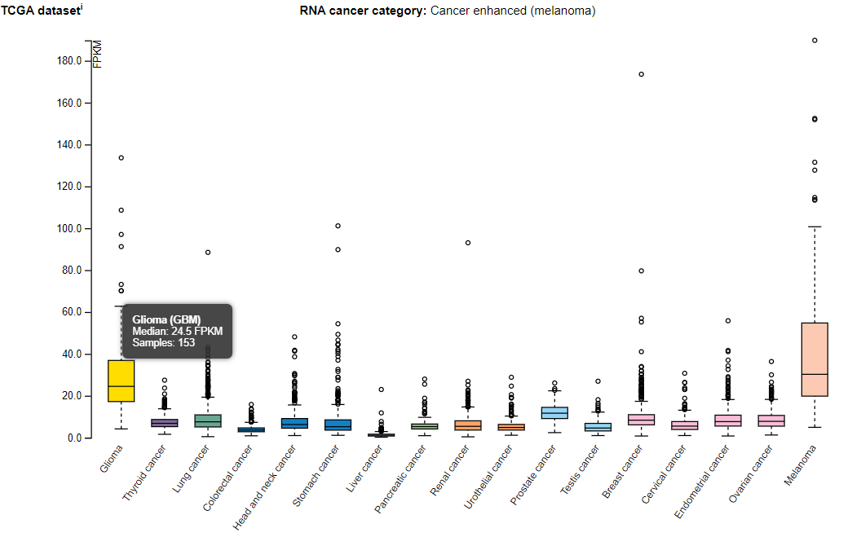
Supplementary Figure 9. Results of survival analysis with GEPIA (left) and RNA expression from the Human Protein Atlas database at ITPKB (right)

Slide 5
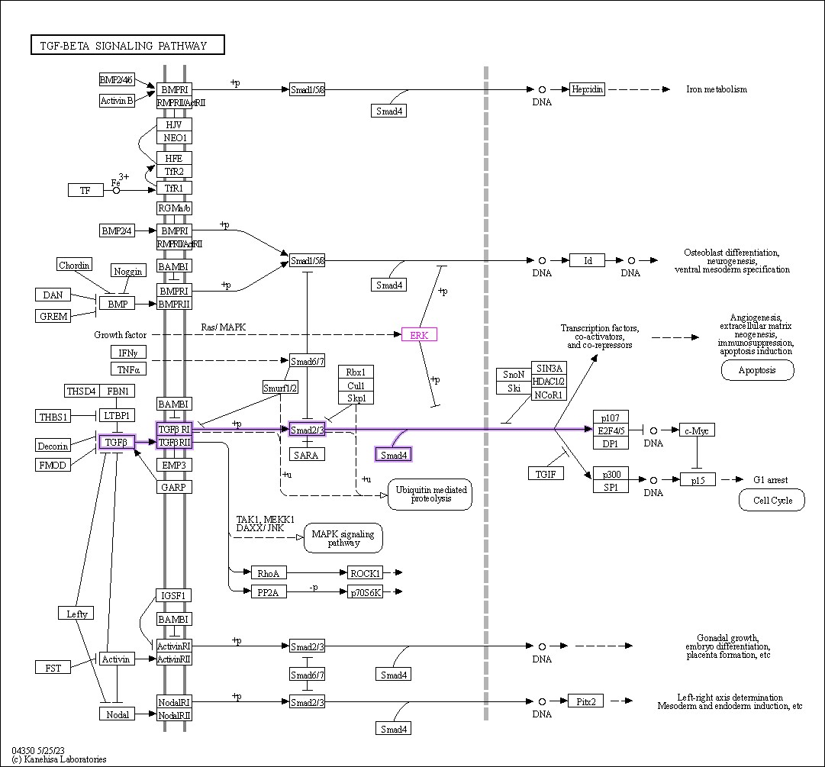
Supplementary Figure 10. Signaling analysis on KEGG related to TGF-β signaling which is related to ERK and regulates the process of apoptosis and G1 arrest in cells as a response to DNA damage

Slide 6
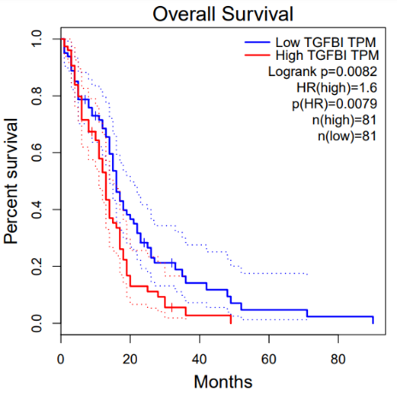
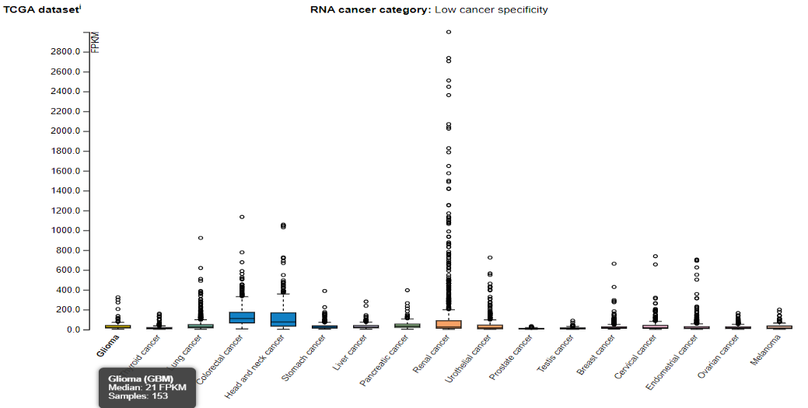
Supplementary Figure 11. Results of survival analysis with GEPIA (left) and RNA expression from the Human Protein Atlas database on TGFBI (right)

Slide 7
Supplementary Figure 12. Activation of MEK/ERK and PI3K/Akt pathway signaling by activation of mPR receptors on the membrane by progestin[26]

Slide 8
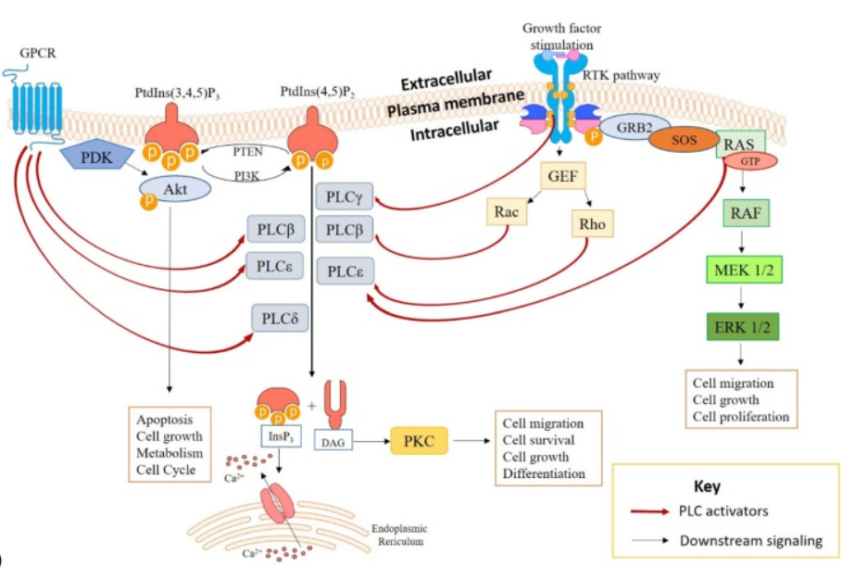
Supplementary Figure 13. The signaling cascade involving IP compounds in the activation of PLC, which together with DAG will release calcium ions in the cytosol. Activation of PKC compounds supports migration, defense, growth and differentiation in cancer cells[34]

Slide 9
Supplementary Figure 14. Hyperactivation of TGF-β will activate anti-apoptotic pathways such as PI3K/Akt in response to DNA damage.[38]

