Slide 1
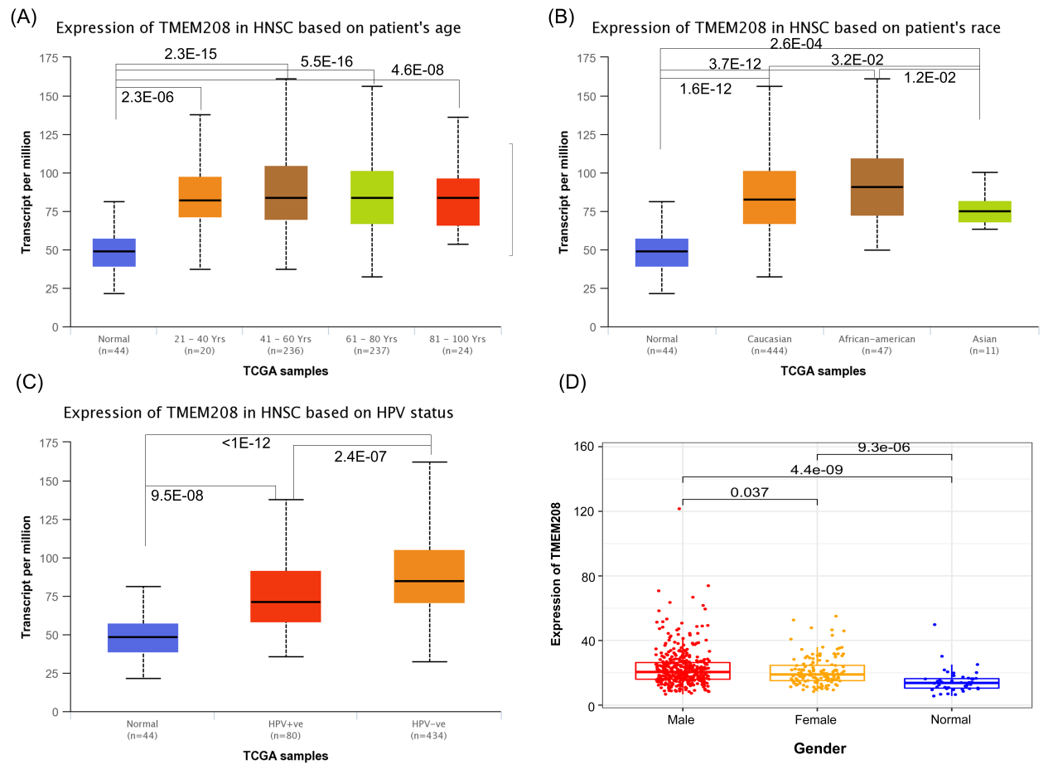
Figure S1. Relationship between TMEM208 expression and age, race, HPV and gender. (A) Significantly higher in all age groups compared to the normal group, but no significant difference between age groups. (B) TMEM208 expression was significantly lower in Asians compared to other races. (C) TMEM208 expression was significantly higher in HPV-negative patients than in HPV-positive patients. (D) TMEM208 was significantly higher expressed in males.

Slide 2
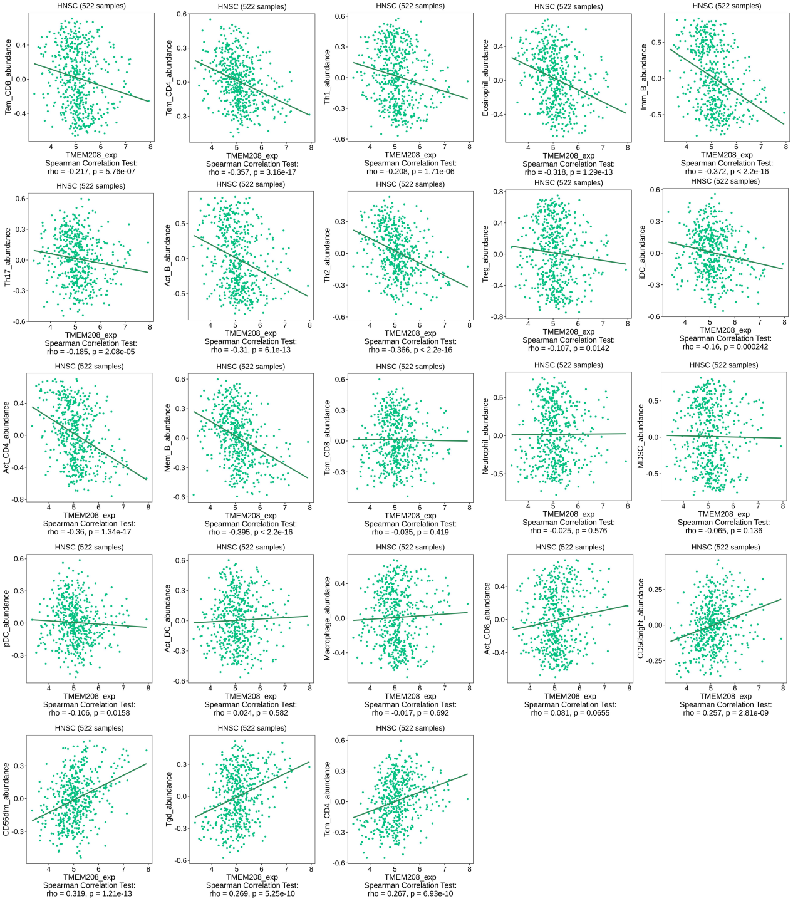
Figure S2. Relationship between TMEM208 expression level and immune cell infiltration level in HNSCC patients.

