Slide 1
Supplementary Figures

Slide 2
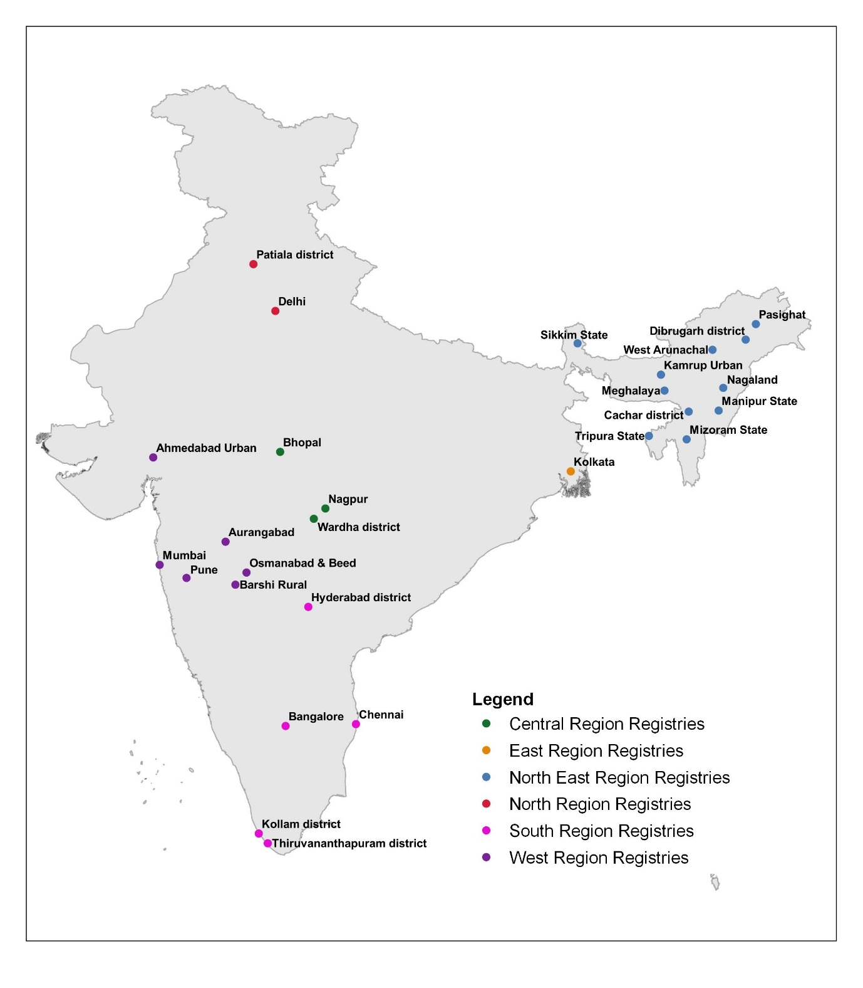
Supplementary fig 1: Distribution of 28 Population Based cancer registries

Slide 3
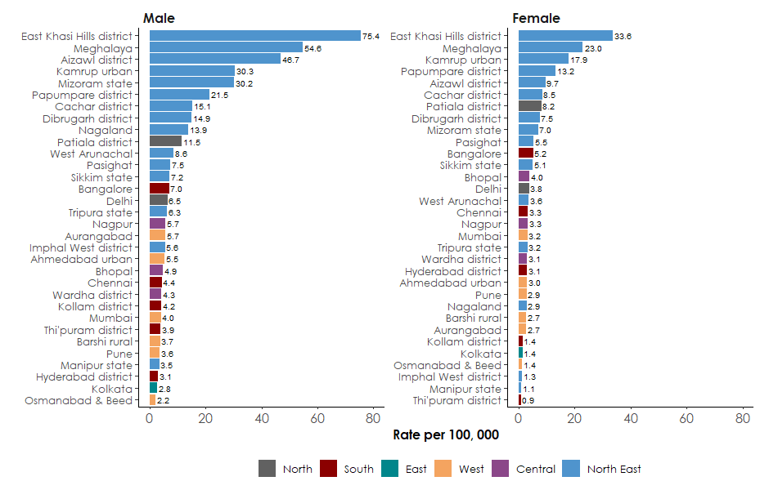
Supplementary Fig: 2. Comparison of age-adjusted incidence rates (AARs) of all population-based cancer registries, 2012-2016
Esophagus

Slide 4
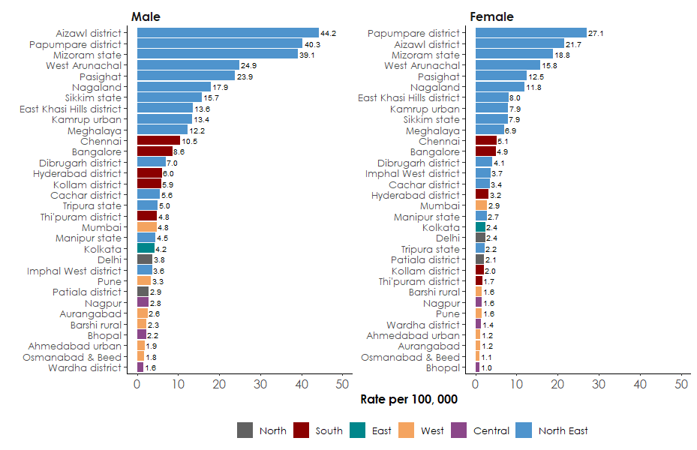
Stomach

Slide 5
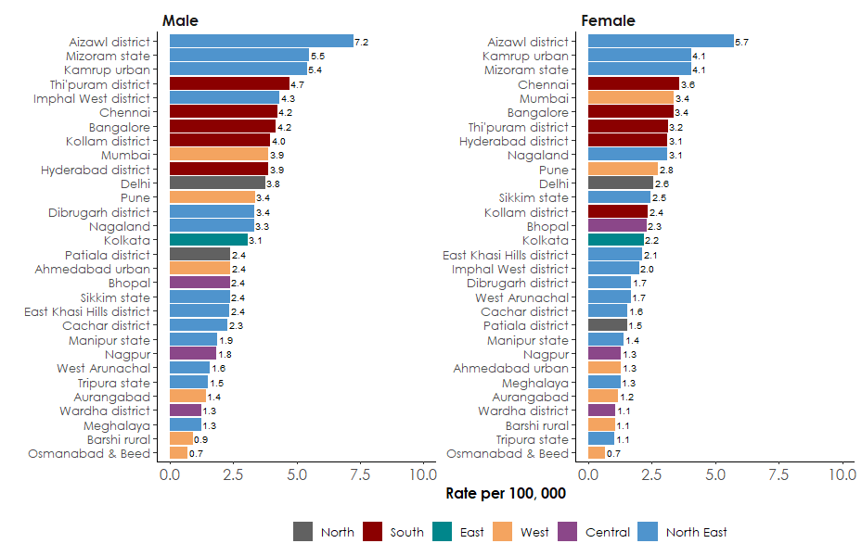
Colon

Slide 6
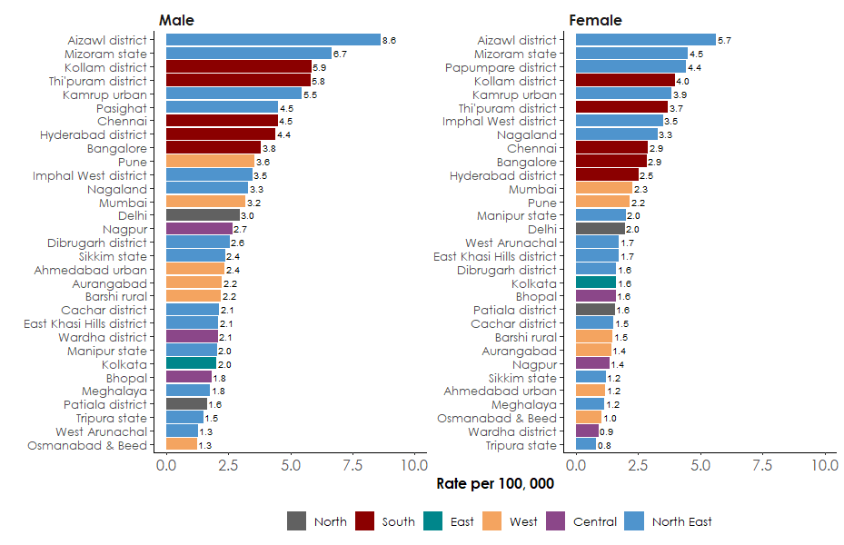
Rectum

Slide 7
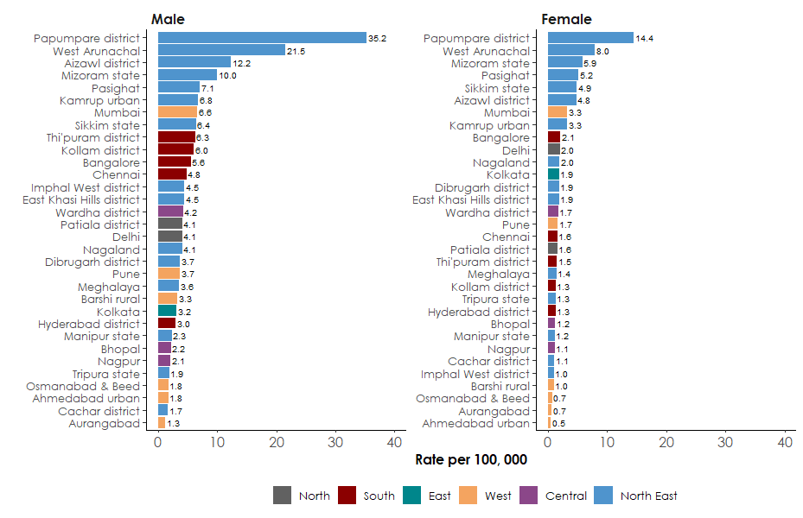
Liver

Slide 8
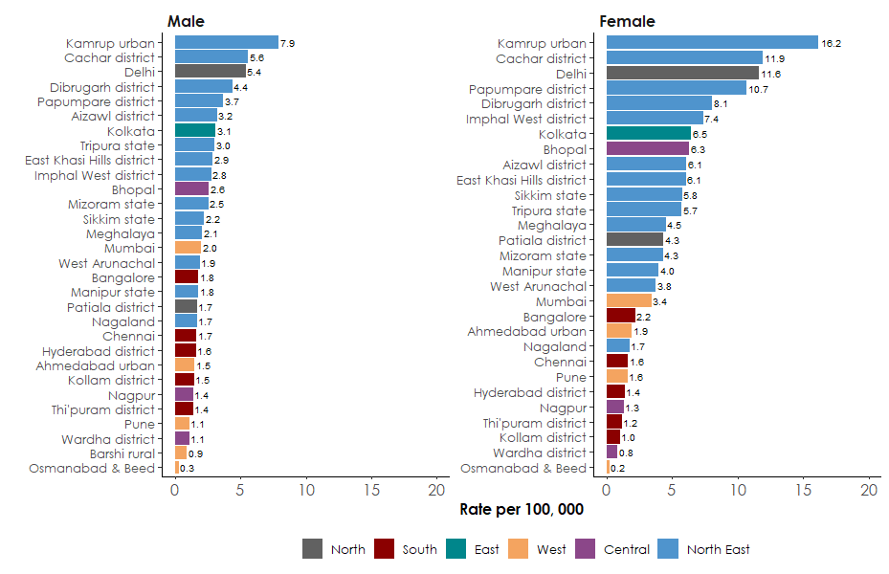
Gallbladder

Slide 9
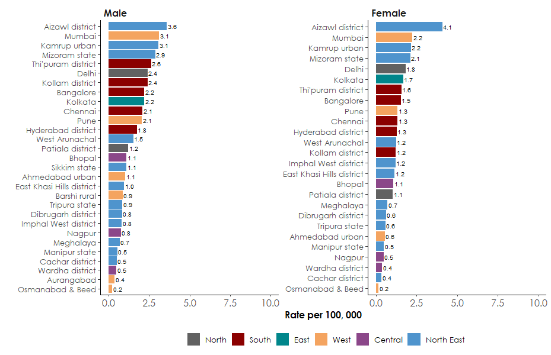
Pancreas

