Slide 1
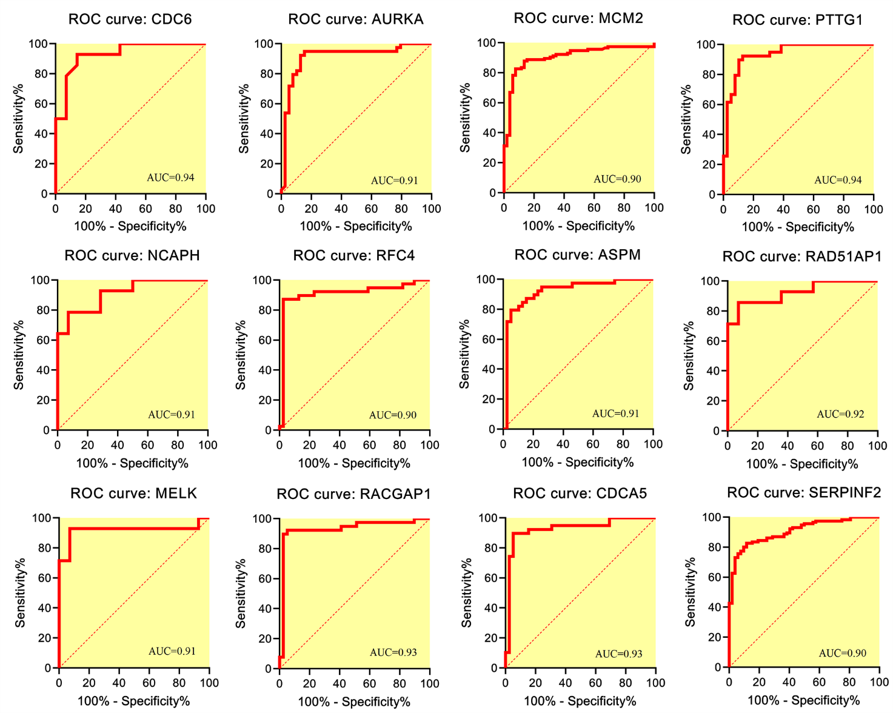
Supplementary Figure 1. ROC curve analysis results for genes with the area under the curve (AUC) ≥0.9 and p-vale <0.05.

Slide 2
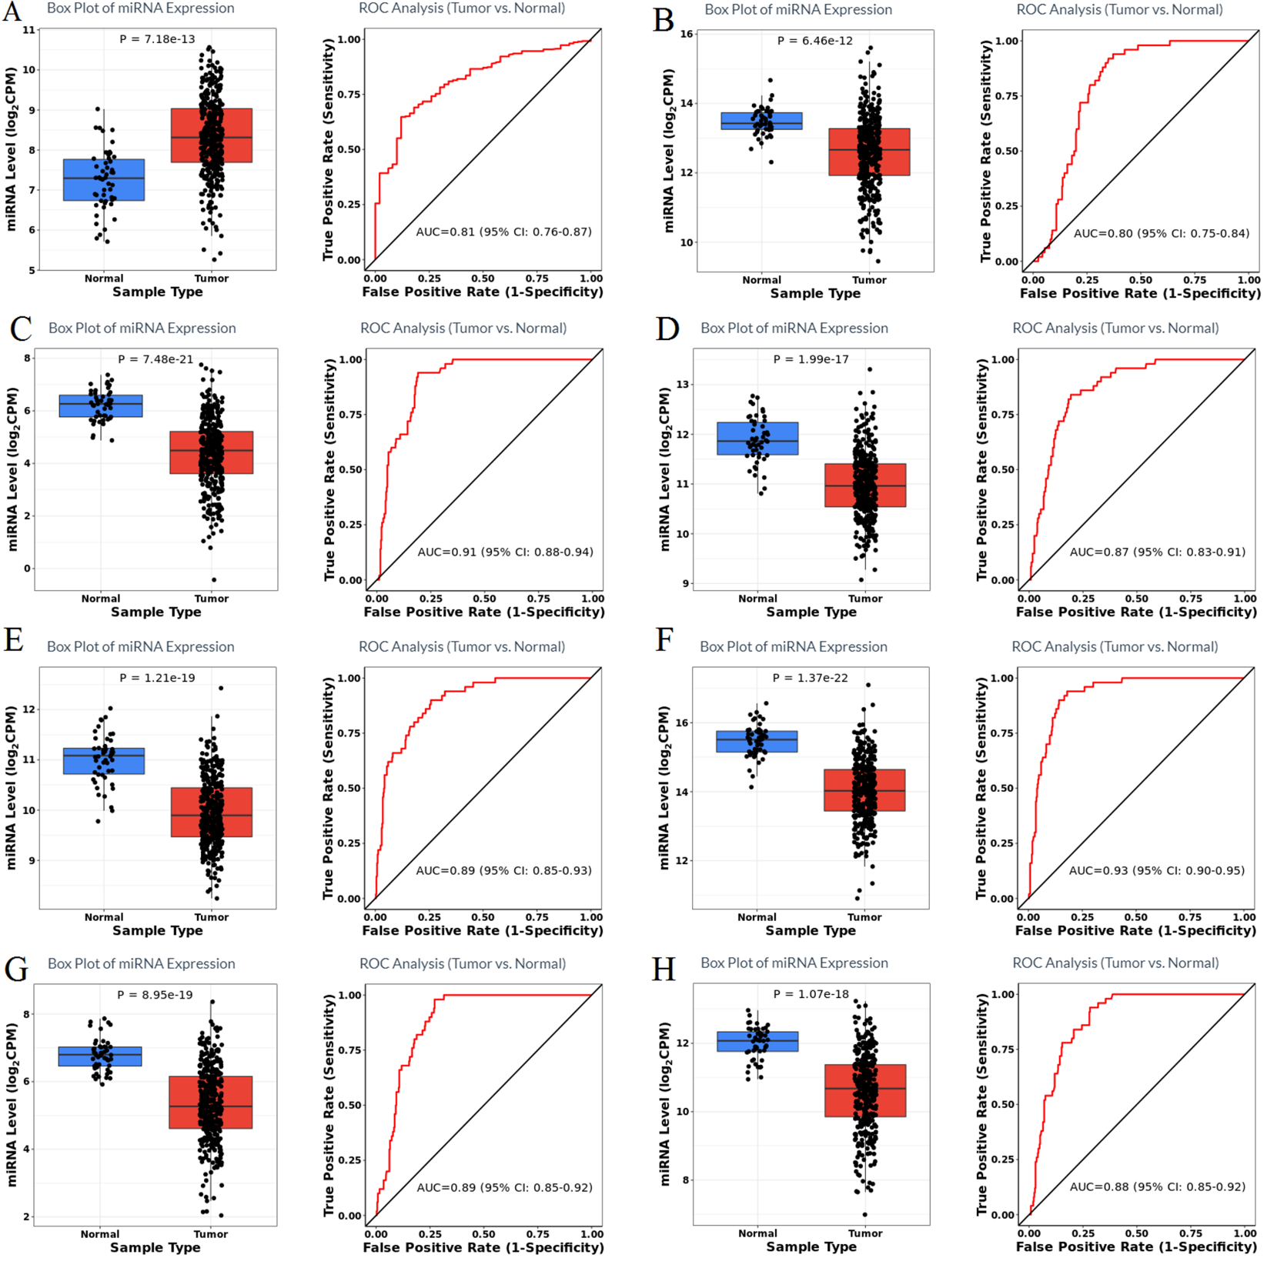
Supplementary Figure 2. The box plots of the expression levels of the miRs with diagnostic value in liver tumor along with their ROC curves with AUC ≥ 0.8. (A) has-mir-34a-5p, (B) hsa-let-7b-5p, (C) has-mir-195-5p, (D) has-mir-26a-5p, (E) has-mir-26b-5p, (F) has-mir-101-3p, (G) has-mir-130a-3p, (H) has-mir-29c-3p.

Slide 3
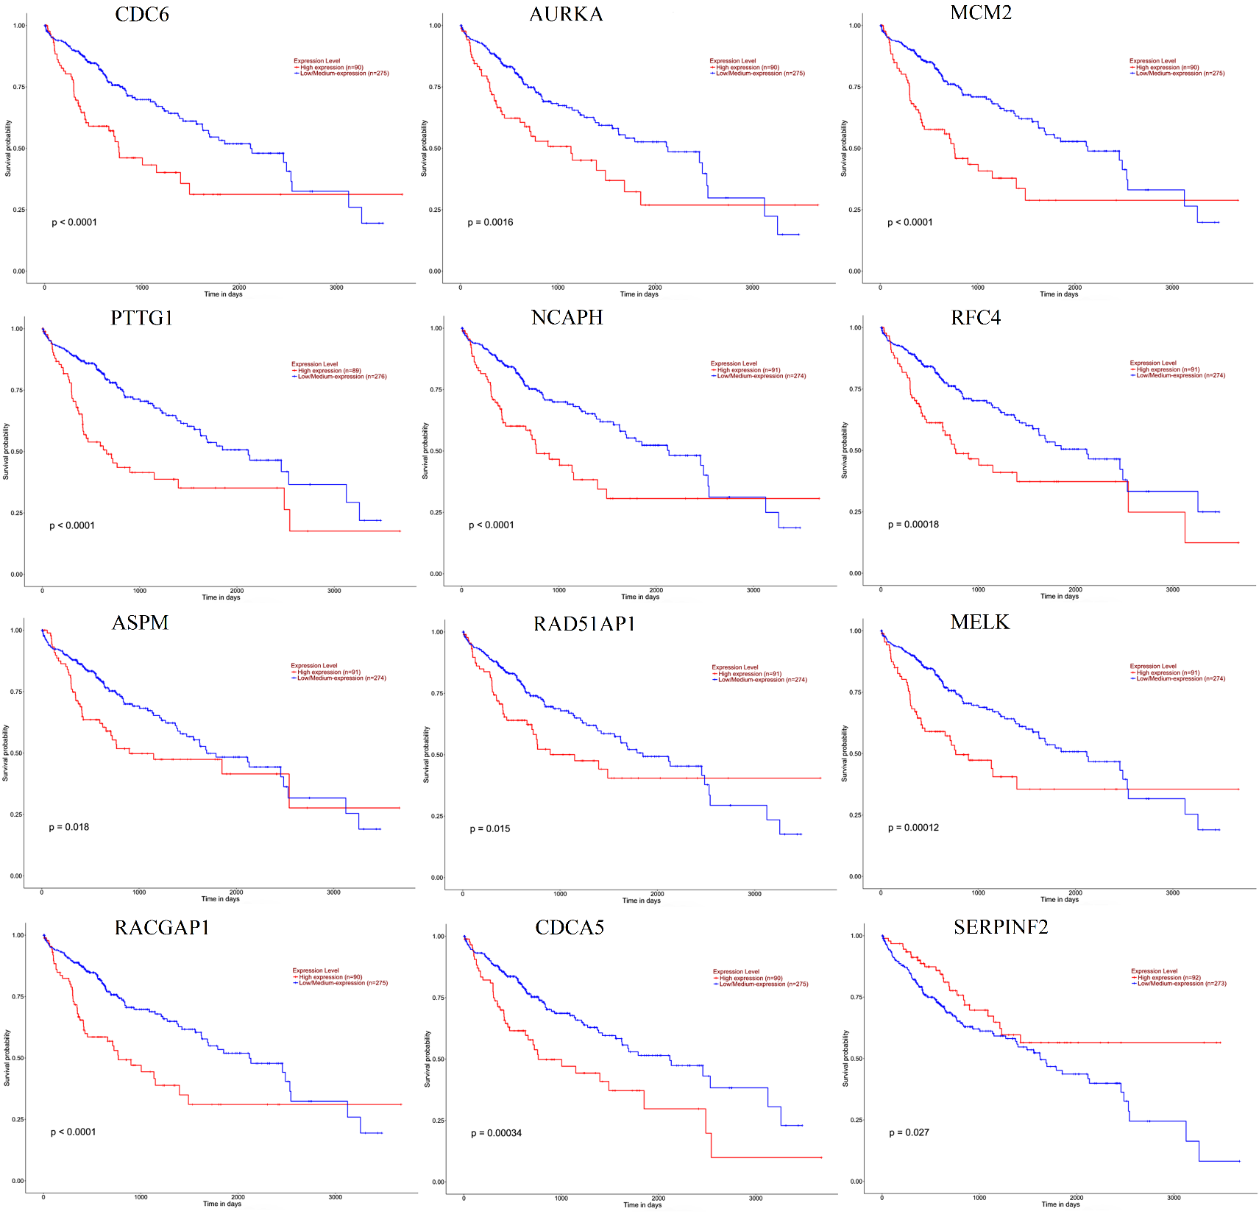
Supplementary Figure 3. Kaplan-Meier survival curves of the genes with the area under the curve (AUC) ≥0.9 and p-vale <0.05 from the UALCAN database, showing the effect of the expression levels on liver cancer survival. Expression of all the genes show unfavorable correlation, where the expression of SERPINF2 show favorable correlation with the survival.

Slide 4
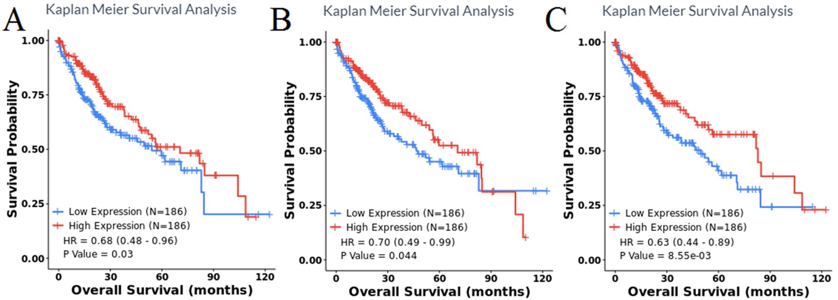
Supplementary Figure 4. The Kaplan-Meier survival curves analysis of (A) hsa-mir-34a-5p, (B) hsa-mir-195-5p, and (C) hsa-mir-130a-3p. Expression of all these 3 miRs show favorable correlation with the overall survival.

Slide 5
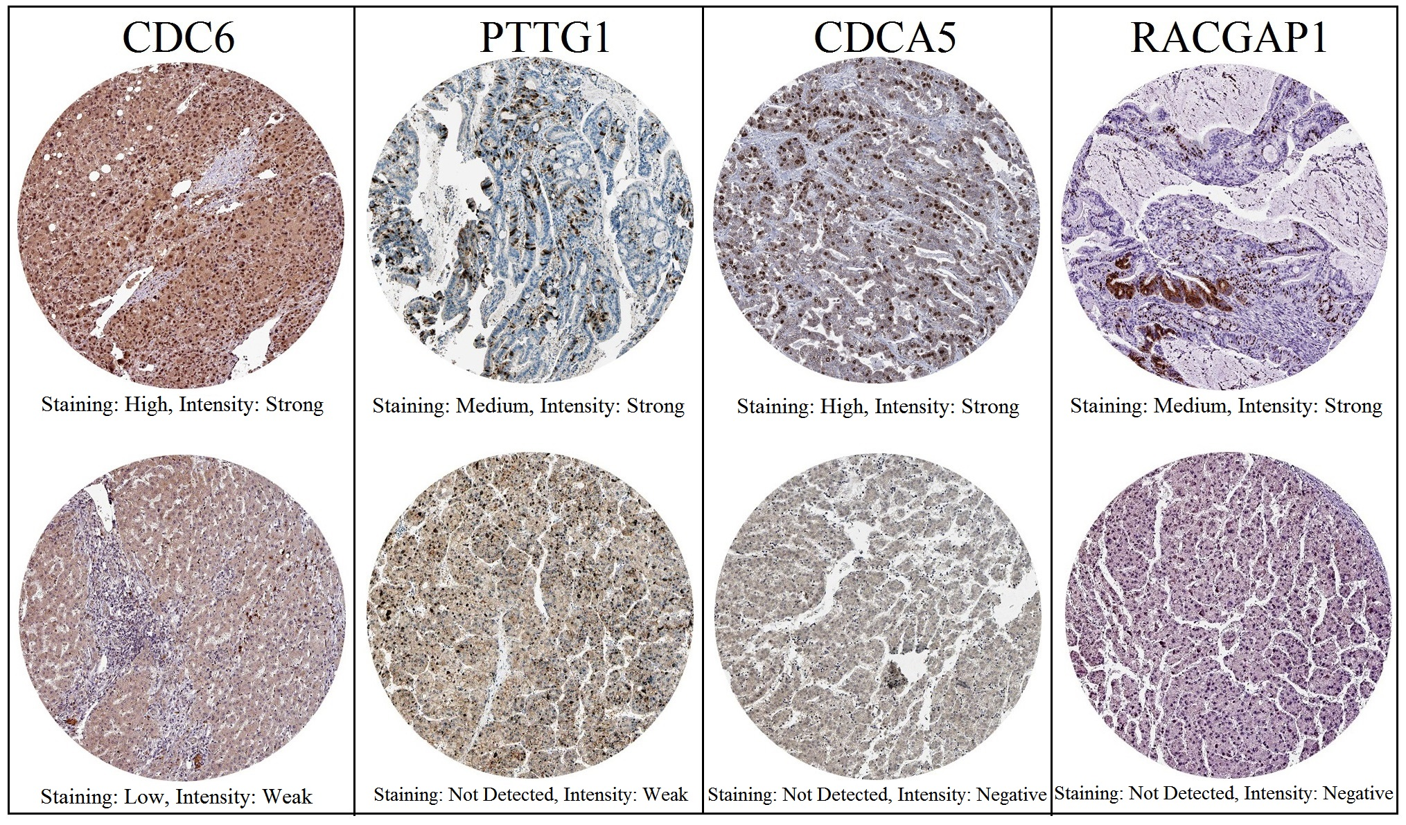
Supplementary Figure 5. Representative protein expressions of CDC6, PTTG1, CDCA5, and RACGAP1 examined by Immunohistochemistry based on the HPA database.

